Slide 1
Learning Causal Networks

Slide 2
Recap
We can model causal and probabilistic relationships among a set of variables with a causal Bayesian network
Graph: Causal Properties.
CPTs P(X|Pa(X)): Joint Probability distribution.
Graph and Joint Probability Distribution connected through the Causal Markov Assumption.
Causal Bayesian networks allow
Factorization
Probabilistic inference
Causal Inference

Slide 3
Today: Learning Causal Networks
What you have
What you want
P(Smoking)
0.3
Sample (Person) | Smoking | CVD | Yellow Teeth
1 | Yes | Yes | No
2 | No | No | No
3 | Yes | Yes | Yes
4 | No | No | Yes
5 | Yes | No | No
6 | No | Yes | Yes
Smoking
Yellow Teeth
CVD
Smoking | P(YT)
Y | 0.85
N | 0.10
Smoking | P(CVD)
Y | 0.75
N | 0.15
…
52 | No | Yes | No

Slide 4

Causal Markov Condition
Graph $G$ captures the qualitative causal relations
JPD $J$encodes the quantitative probabilistic properties
Smoking
 |  | CVD
Yellow Teeth | Smoking | Y | N
Y | Y | 0.17 | 0.06 | 0.13
N | Y | 0.06 | 0.02 | 0.08
Y | N | 0.02 | 0.06 | 0.08
N | N | 0.15 | 0.46 | 0.61
 |  | 0.4 | 0.6 | 1
Yellow Teeth
CVD
Causal Markov Condition (CMC):
Every variable is independent of its non-effects (non-descendants in the graph) given its direct causes (parents).

Slide 5
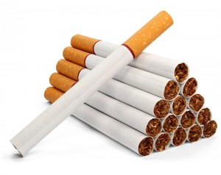
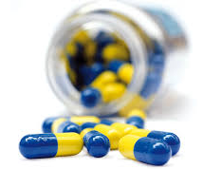
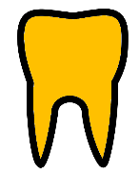

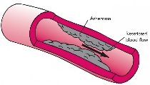

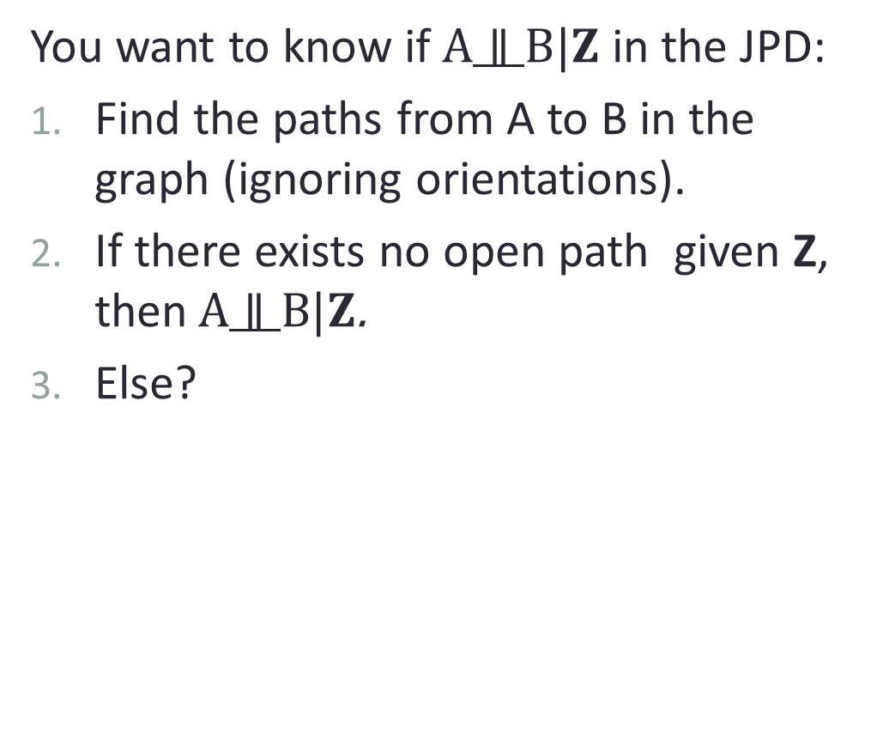
d-connection and conditional dependencies
You want to know if$A∥B|Z$ in the JPD:
Find the paths from A to B in the graph (ignoring orientations).
If there exists no open path given Z, then$A∥B|Z$.
Else?
Smoking
Medicine Y
Yellow
Teeth
Levels of Protein X
CVD
Fatigue

Slide 6
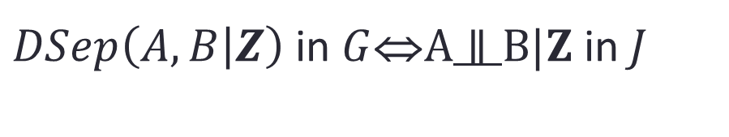
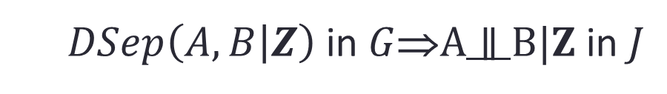
Faithfulness
Faithfulness Condition:
Independences stem only from the causal structure, not the parameterization of the distribution.
We say that the graph and the distribution are faithful to each other.
CMC
$DSep\left(A, B | Z\right)$in $G$⇒$A∥B|Z \text{in} J$
CMC+FAITHFULNESS
$DSep\left(A, B | Z\right) \text{in} G$⇔$A∥B|Z \text{in} J$
Independencies stem from the causal structure, are not accidental properties of the parameters

Slide 7
Faithfulness
Sunscreen
Sun
Melanoma
The parameters do not cancel each other out!

Slide 8
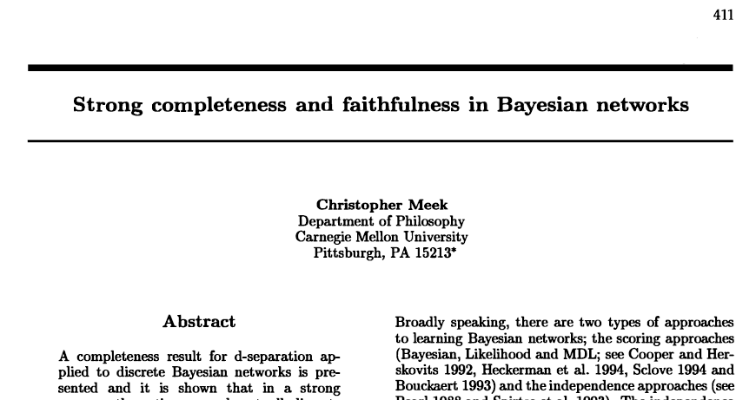
Faithfulness
Is it realistic?
Assume you are given a graph and you select the parameters of the conditional probability tables randomly following a Dirichlet distribution.
The probability you get a non-faithful BN is zero (Lebesque measure is zero).
[Meek. C. UAI 1995]

Slide 9
Faithfulness
Is it realistic?
Probable causes of non-faithfulness:
Too low associations are not detectable for finite samples.
Too high correlations (determinism or close-to-determinism).
Natural selection may be biasing towards creating non-faithful distributions in systems in nature (e.g.. cells)!
Not all joint probability distributions have a faithful representation.
The probability of getting an almost non-faithful distribution is non-zero.

Slide 10
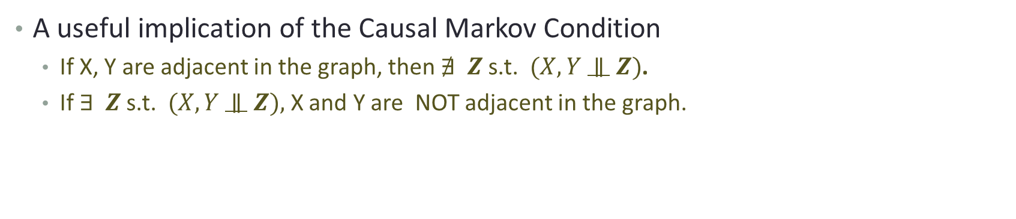
Causal Markov Condition + Faithfulness
X
Y
X
Y
The edge is a d-connecting path that can not be broken given any other variables.
A useful implication of the Causal Markov Condition
If X, Y are adjacent in the graph, then $∄ Z$s.t. $(X, Y$ $∥$ $Z)$.
If $∃ Z$s.t. $(X, Y$ $∥$ $Z),$ X and Y are NOT adjacent in the graph.
Apart from the causal semantics, an edge denotes unique information (given all other variables)

Slide 11


Causal Bayesian Networks (CBNs)
Graph G
JPD($V$): J
Smoking
 |  | CVD
Yellow Teeth | Smoking | Y | N
Y | Y | 0.17 | 0.06 | 0.13
N | Y | 0.06 | 0.02 | 0.08
Y | N | 0.02 | 0.06 | 0.08
N | N | 0.15 | 0.46 | 0.61
 |  | 0.4 | 0.6 | 1
Yellow Teeth
CVD
Causal Markov Condition +
Faithfulness =
Independence $↔$ D-separation
Notes:
Causal Bayesian Networks: A Graph and a probability distribution

Slide 12
Reverse-engineering the graph
What you have
What you want
P(Smoking)
0.3
Sample (Person) | Smoking | CVD | Yellow Teeth
1 | Yes | Yes | No
2 | No | No | No
3 | Yes | Yes | Yes
4 | No | No | Yes
5 | Yes | No | No
6 | No | Yes | Yes
Smoking
Yellow Teeth
CVD
Smoking | P(YT)
Y | 0.85
N | 0.10
Smoking | P(CVD)
Y | 0.75
N | 0.15
…
52 | No | Yes | No

Slide 13

Reverse-engineering the graph
What you have
What you want
P(Smoking)
0.3
You can use tests of conditional independence to identify the set of conditional independencies:
Here you only have one independence:
$\text{CVD}∥\text{Yellow} \text{Teeth}$|Smoking
And the rest are dependencies:
$\text{Smoking} ∦\text{Yellow} \text{Teeth}$|$∅$
$\text{Smoking} ∦\text{Yellow} \text{Teeth}$|CVD
$\text{Smoking} ∦\text{CVD}$|$∅$
$\text{Smoking} ∦\text{CVD}$|Yellow Teeth
Smoking
Yellow Teeth
CVD
Smoking | P(YT)
Y | 0.85
N | 0.10
Smoking | P(CVD)
Y | 0.75
N | 0.15
Can we find the graph where the only d-separation is CVD and Yellow teeth given smoking?

Slide 14



Markov Equivalence
Smoking
Smoking
Yellow Teeth
CVD
Yellow Teeth
CVD
$\text{CVD}∥\text{Yellow} \text{Teeth}$|$Smoking$
$\text{CVD}∥\text{Yellow} \text{Teeth}$|$Smoking$
Smoking
Causal Markov Condition entails the same conditional independence for all three graphs.
Yellow Teeth
CVD
$\text{CVD}∥\text{Yellow} \text{Teeth}$|$Smoking$

Slide 15
Markov Equivalence
Smoking
Smoking
Yellow Teeth
CVD
Yellow Teeth
CVD
$\text{CVD}∥\text{Yellow} \text{Teeth}$|$Smoking$
$\text{CVD}∥\text{Yellow} \text{Teeth}$|$Smoking$
Smoking
The graphs are called Markov Equivalent.
All Markov equivalent graphs denote a Markov equivalence class (MEC).
We use [G] to denote the MEC of G.
Yellow Teeth
CVD
$\text{CVD}∥\text{Yellow} \text{Teeth}$|$Smoking$

Slide 16
Markov Equivalence
Smoking
Smoking
Yellow Teeth
CVD
Yellow Teeth
CVD
$\text{CVD}∥\text{Yellow} \text{Teeth}$|$Smoking$
$\text{CVD}∥\text{Yellow} \text{Teeth}$|$Smoking$
Smoking
Markov Equivalent Graphs share
the same skeleton (adjacencies).
the same unshielded colliders
Yellow Teeth
CVD
$\text{CVD}∥\text{Yellow} \text{Teeth}$|$Smoking$

Slide 17
Reminder: (non) colliders
X
Z
X
Z
X
Z
X
Z
Y
Y
Y
Y
collider
non- collider
non- collider
non- collider
For a triple X-Y-Z:
The term is used to denote both the triplet and the middle node!
If both edges are into Y, the triplet (and Y) is a collider.
Otherwise the triplet (and Y) is a non-collider.

Slide 18
Characterization of the Markov Equivalence Class
Unshielded collider: A collider (X-Y-Z) where the endpoints (X, Z) are NOT adjacent.
AKA v-structure.
v-structure
not a v-structure

Slide 19
Pattern DAGs
Represents a class of Markov Equivalent DAGs.
Has the same edges as every DAG in the class.
Has only orientations (arrows) shared by all the DAGs in the class.
Orient the PDAG as a DAG without creating a new collider or directed cycle!
PDAG
Not all configurations are possible!

Slide 20
Pattern DAGs
DAG
PDAG
You can still “read” all conditional independencies entailed by the Causal Markov Condition in the graph using d-separation.

Slide 21
Modelling Interventions with PDAGs
You cannot model all interventions.
Only if you know the edges that are incoming to the manipulated variable.
PDAGs can help you design experiments to disambiguate a structure.
PDAG

Slide 22

Reverse-engineering
Causal Bayesian Network describing your variables
Smoking
Yellow Teeth
CVD
Independencies entailed by the CMC
$\text{CVD}∥\text{Yellow} \text{Teeth}$|Smoking
For a causal structure, Causal Markov Condition entails a (possibly empty) set of conditional independencies.

Slide 23


Reverse-engineering
Causal Bayesian Network describing your variables
Smoking
Smoking
Smoking
Yellow Teeth
CVD
Yellow Teeth
CVD
Yellow Teeth
CVD
Independencies entailed by the CMC
$\text{CVD}∥\text{Yellow} \text{Teeth}$|Smoking
$\text{CVD}∥\text{Yellow} \text{Teeth}$|Smoking
$\text{CVD}∥\text{Yellow} \text{Teeth}$|Smoking
The same set of conditional independencies is entailed by all Markov equivalent networks.

Slide 24
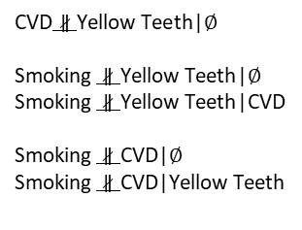
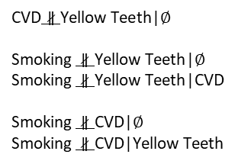
Reverse-engineering
Causal Bayesian Network describing your variables
Smoking
Smoking
Smoking
Yellow Teeth
CVD
Yellow Teeth
CVD
Yellow Teeth
CVD
Independencies entailed by the CMC
$\text{CVD}∥\text{Yellow} \text{Teeth}$|Smoking
$\text{CVD}∥\text{Yellow} \text{Teeth}$|Smoking
$\text{CVD}∥\text{Yellow} \text{Teeth}$|Smoking
Under Faithfulness
$\text{CVD}∦\text{Yellow} \text{Teeth}$|$∅$
$\text{Smoking} ∦\text{Yellow} \text{Teeth}$|$∅$
$\text{Smoking} ∦\text{Yellow} \text{Teeth}$|CVD
$\text{Smoking} ∦\text{CVD}$|$∅$
$\text{Smoking} ∦\text{CVD}$|Yellow Teeth
$\text{CVD}∦\text{Yellow} \text{Teeth}$|$∅$
$\text{Smoking} ∦\text{Yellow} \text{Teeth}$|$∅$
$\text{Smoking} ∦\text{Yellow} \text{Teeth}$|CVD
$\text{Smoking} ∦\text{CVD}$|$∅$
$\text{Smoking} ∦\text{CVD}$|Yellow Teeth
$\text{CVD}∦\text{Yellow} \text{Teeth}$|$∅$
$\text{Smoking} ∦\text{Yellow} \text{Teeth}$|$∅$
$\text{Smoking} ∦\text{Yellow} \text{Teeth}$|CVD
$\text{Smoking} ∦\text{CVD}$|$∅$
$\text{Smoking} ∦\text{CVD}$|Yellow Teeth
If you also assume faithfulness, all remaining relationships are conditional dependencies.

Slide 25
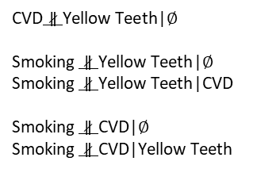
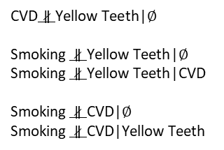
Reverse-engineering
Causal Bayesian Network describing your variables
Smoking
Smoking
Smoking
Yellow Teeth
CVD
Yellow Teeth
CVD
Yellow Teeth
CVD
Independencies entailed by the CMC
$\text{CVD}∥\text{Yellow} \text{Teeth}$|Smoking
$\text{CVD}∥\text{Yellow} \text{Teeth}$|Smoking
$\text{CVD}∥\text{Yellow} \text{Teeth}$|Smoking
Query the data to get the conditional (in) dependencies
Under Faithfulness
$\text{CVD}∦\text{Yellow} \text{Teeth}$|$∅$
$\text{Smoking} ∦\text{Yellow} \text{Teeth}$|$∅$
$\text{Smoking} ∦\text{Yellow} \text{Teeth}$|CVD
$\text{Smoking} ∦\text{CVD}$|$∅$
$\text{Smoking} ∦\text{CVD}$|Yellow Teeth
$\text{CVD}∦\text{Yellow} \text{Teeth}$|$∅$
$\text{Smoking} ∦\text{Yellow} \text{Teeth}$|$∅$
$\text{Smoking} ∦\text{Yellow} \text{Teeth}$|CVD
$\text{Smoking} ∦\text{CVD}$|$∅$
$\text{Smoking} ∦\text{CVD}$|Yellow Teeth
$\text{CVD}∦\text{Yellow} \text{Teeth}$|$∅$
$\text{Smoking} ∦\text{Yellow} \text{Teeth}$|$∅$
$\text{Smoking} ∦\text{Yellow} \text{Teeth}$|CVD
$\text{Smoking} ∦\text{CVD}$|$∅$
$\text{Smoking} ∦\text{CVD}$|Yellow Teeth

Slide 26
Reverse-engineering the PDAG
Identify all DAGs that entail these (and only these) conditional independencies.
Causal Bayesian Network describing your variables
Smoking
Smoking
Smoking
Yellow Teeth
CVD
Yellow Teeth
CVD
Yellow Teeth
CVD
Independencies entailed by the CMC
$\text{CVD}∥\text{Yellow} \text{Teeth}$|Smoking
$\text{CVD}∥\text{Yellow} \text{Teeth}$|Smoking
$\text{CVD}∥\text{Yellow} \text{Teeth}$|Smoking
Query the data to get the conditional (in) dependencies
Under Faithfulness
$\text{CVD}∦\text{Yellow} \text{Teeth}$|$∅$
$\text{Smoking} ∦\text{Yellow} \text{Teeth}$|$∅$
$\text{Smoking} ∦\text{Yellow} \text{Teeth}$|CVD
$\text{Smoking} ∦\text{CVD}$|$∅$
$\text{Smoking} ∦\text{CVD}$|Yellow Teeth
$\text{CVD}∦\text{Yellow} \text{Teeth}$|$∅$
$\text{Smoking} ∦\text{Yellow} \text{Teeth}$|$∅$
$\text{Smoking} ∦\text{Yellow} \text{Teeth}$|CVD
$\text{Smoking} ∦\text{CVD}$|$∅$
$\text{Smoking} ∦\text{CVD}$|Yellow Teeth
$\text{CVD}∦\text{Yellow} \text{Teeth}$|$∅$
$\text{Smoking} ∦\text{Yellow} \text{Teeth}$|$∅$
$\text{Smoking} ∦\text{Yellow} \text{Teeth}$|CVD
$\text{Smoking} ∦\text{CVD}$|$∅$
$\text{Smoking} ∦\text{CVD}$|Yellow Teeth
Brute force: generate all possible DAGs and test using d-separation.

Slide 27
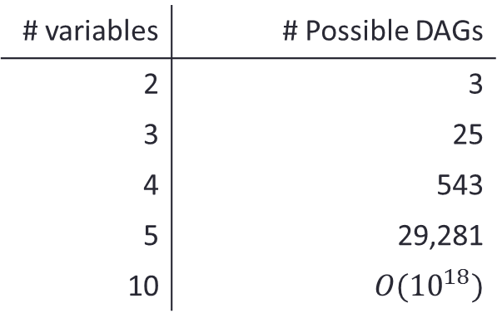
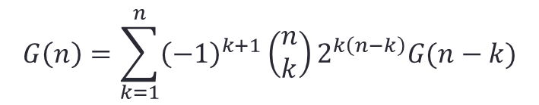
Learning Causal Networks is NP-complete
How many possible DAGs?
# variables | # Possible DAGs
2 | 3
3 | 25
4 | 543
5 | 29,281
10 | $$O({10}^{18})$$
$$G\left(n\right)=\sum_{k=1}^{n}{{\left(−1\right)}^{k+1}\left(\begin{matrix}n \\ k\end{matrix}\right)}2^{k\left(n−k\right)}G(n−k)$$
[Gillespie and Perlman 2001, 2002]

Slide 28
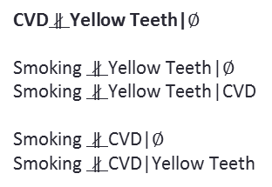
Reverse-engineering
Identify all PDAGs that entail these (and only these) conditional independencies.
Causal PDAG describing your variables
Smoking
Yellow Teeth
CVD
Independencies entailed by the CMC
$\text{CVD}∥\text{Yellow} \text{Teeth}$|Smoking
Query the data to get the conditional (in) dependencies
Under Faithfulness
$\text{CVD}∦\text{Yellow} \text{Teeth}$|$∅$
$\text{Smoking} ∦\text{Yellow} \text{Teeth}$|$∅$
$\text{Smoking} ∦\text{Yellow} \text{Teeth}$|CVD
$\text{Smoking} ∦\text{CVD}$|$∅$
$\text{Smoking} ∦\text{CVD}$|Yellow Teeth
Brute force: generate all possible PDAGs and test using d-separation.

Slide 29
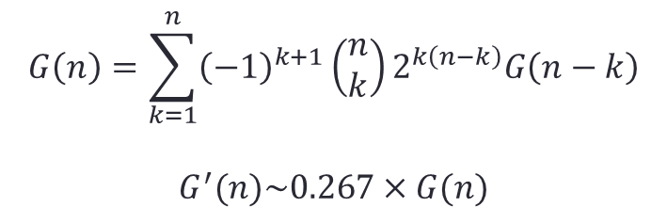
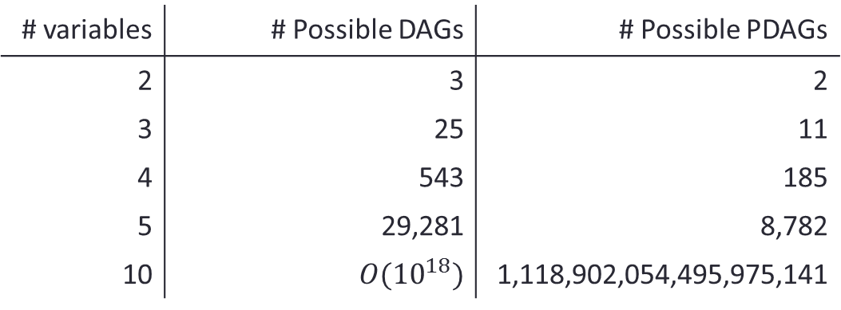
Still NP-Complete
How many possible PDAGs?
# variables | # Possible DAGs | # Possible PDAGs
2 | 3 | 2
3 | 25 | 11
4 | 543 | 185
5 | 29,281 | 8,782
10 | $$O({10}^{18})$$ | 1,118,902,054,495,975,141
$$G\left(n\right)=\sum_{k=1}^{n}{{\left(−1\right)}^{k+1}\left(\begin{matrix}n \\ k\end{matrix}\right)}2^{k\left(n−k\right)}G\left(n−k\right)$$
$$G^{′}(n)\sim 0.267×G(n)$$
[Gillespie and Perlman 2001, 2002]

Slide 30
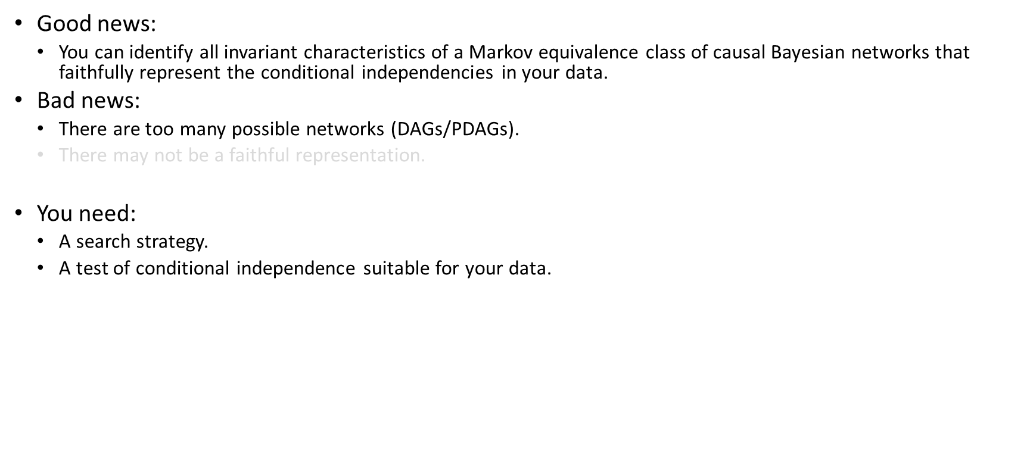
Learning Causal Networks : Constraint-based approach
Good news:
You can identify all invariant characteristics of a Markov equivalence class of causal Bayesian networks that faithfully represent the conditional independencies in your data.
Bad news:
There are too many possible networks (DAGs/PDAGs).
There may not be a faithful representation.
You need:
A search strategy.
A test of conditional independence suitable for your data.
Typical search strategy:
Start from the full network.
For each pair of variables X, Y, look for a set of observed variables Z such that $\text{X}∦\text{Y}$|Z.
If you find one, remove X-Y.
Orient invariant features of the Markov equivalence class.

Slide 31
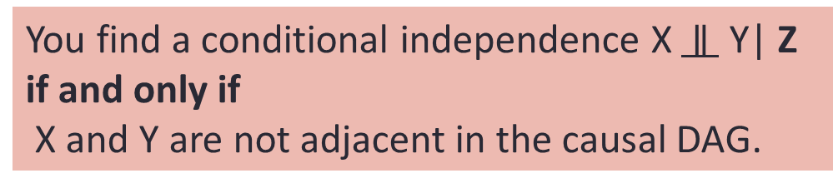
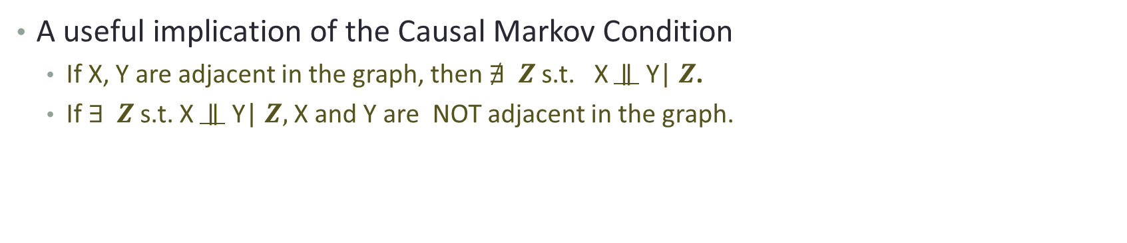
Reminder : Causal Markov Condition + Faithfulness
X
Y
X
Y
The edge is a d-connecting path that can not be broken given any other variables.
A useful implication of the Causal Markov Condition
If X, Y are adjacent in the graph, then $∄ Z$s.t. X $∥$ Y| $Z$.
If $∃ Z$s.t. X $∥$ Y| $Z,$ X and Y are NOT adjacent in the graph.
You find a conditional independence X $∥$ Y| Z
if and only if
X and Y are not adjacent in the causal DAG.

Slide 32
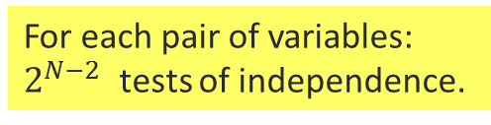

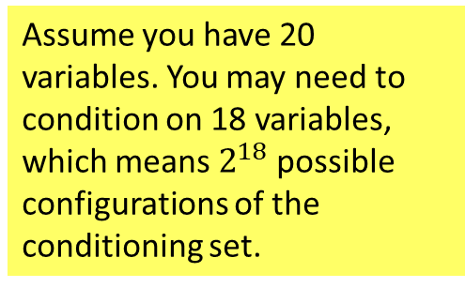
Learning the skeleton of a CBN
Search strategy:
Identify the skeleton of your PDAG:
Begin with the full graph.
For each pair of adjacent variables look for a set of observed variables Z such that $\text{X}∥\text{Y}$|Z.
If you find succeed, remove X-Y.
Until no more edges can be removed.
For each pair of variables: $2^{N−2}$ tests of independence.
Assume you have 20 variables. You may need to condition on 18 variables, which means $2^{18}$ possible configurations of the conditioning set.
You need a MANY samples
For finite sizes, very low power, tests that cannot be performed.

Slide 33
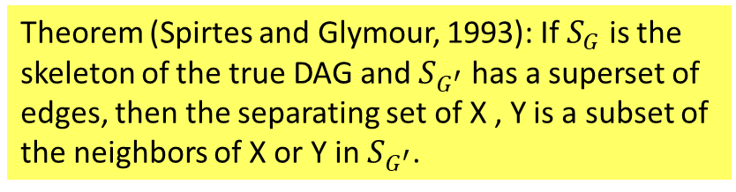

Learning the skeleton of a CBN
Search strategy:
Identify the skeleton of your PDAG:
Begin with the full graph.
For each pair of adjacent variables look for a set of observed variables Z such that $\text{X}∥\text{Y}$|Z.
If you find succeed, remove X-Y.
Until no more edges can be removed.
Theorem (Spirtes and Glymour, 1993): If $S_{G}$ is the skeleton of the true DAG and $S_{G^{′}}$ has a superset of edges, then the separating set of X , Y is a subset of the neighbors of X or Y in $S_{G^{′}}$.
You do not know the neighbors of each node.
You begin with the full graph, so at each step of the algorithm you each variable is adjacent to a superset of its real neighbors.
As you remove edges, the neighbor sets are reduced.
You only have to check the adjacent nodes of X or Y at the current step of the algorithm.
For a sparse graph, this really speeds up the skeleton search.
Worst-case complexity is still exponential.

Slide 34
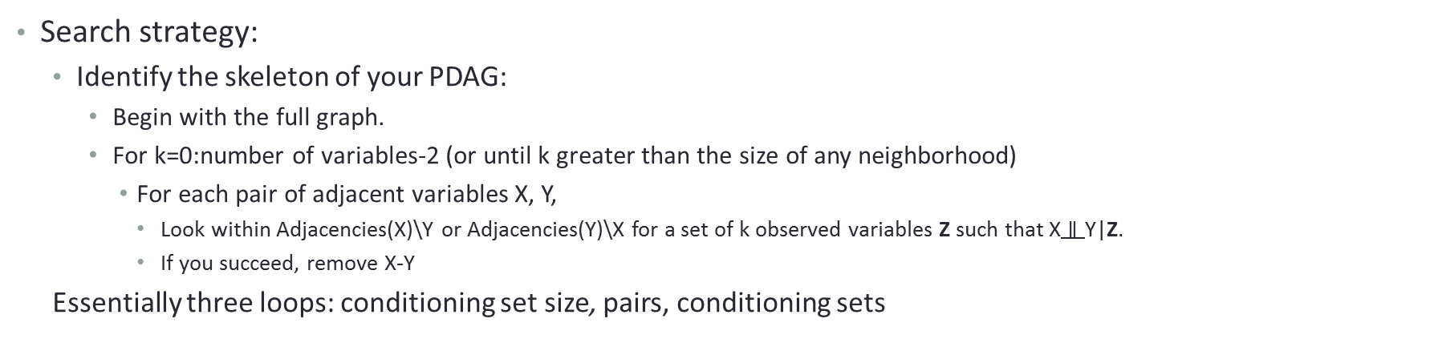
Learning the skeleton of a CBN: PC algorithm
Search strategy:
Identify the skeleton of your PDAG:
Begin with the full graph.
For k=0:number of variables-2 (or until k greater than the size of any neighborhood)
For each pair of adjacent variables X, Y,
Look within Adjacencies(X)\Y or Adjacencies(Y)\X for a set of k observed variables Z such that $\text{X}∥\text{Y}$|Z.
If you succeed, remove X-Y
Essentially three loops: conditioning set size, pairs, conditioning sets

Slide 35
Learning the skeleton of a CBN: PC algorithm
Search strategy:
Identify the skeleton of your PDAG:
Begin with the full graph.
For k=0:number of variables-2 (or until k greater than the size of any neighborhood)
For each pair of adjacent variables X, Y,
Look within Adjacencies(X)\Y or Adjacencies(Y)\X for a set of k observed variables Z such that $\text{X}∥\text{Y}$|Z.
If you succeed, remove X-Y
Essentially three loops: conditioning set size, pairs, conditioning sets
How do you pick which edges/neighbors to try first?
Naïve choice: lexicographic order
Smart choice: (HEURISTIC 3, Causation, Prediction and Search, 1993):
You want to remove edges (X, Y) and you are looking for conditioning sets within Adjacencies(X)\Y.
-Start from the pair (X, Y) with the weakest pairwise association.
(weakest pairwise association more likely corresponds to non-adjacent variables)
-Start from the neighbor with the highest pairwise association with X (or Y).
(variables strongly associated with X are more probable to be neighbors/mediators on the path from X to Y)

Slide 36
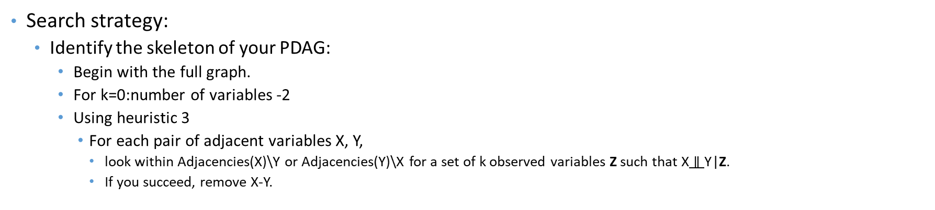
Learning the skeleton of a CBN
Search strategy:
Identify the skeleton of your PDAG:
Begin with the full graph.
For k=0:number of variables -2
Using heuristic 3
For each pair of adjacent variables X, Y,
look within Adjacencies(X)\Y or Adjacencies(Y)\X for a set of k observed variables Z such that $\text{X}∥\text{Y}$|Z.
If you succeed, remove X-Y.
You have identified the skeleton of your graph!
This is the skeleton identification step of the PC algorithm, introduced in 1993 by Peter Spirtes and Clark Glymour.

Slide 37
PC Algorithm – an example
Dataset measuring your variables.
TRUE, UNKNOWN causal DAG
Smoking
Medicine Y
Variables Samples | Yellow Teeth | Smoking | CVD | Medicine Y | Levels of Protein X
1
2
3
4
5
6
7
8
9
...
999
1000
Yellow
Teeth
Levels of Protein X
CVD
Let’s see an example of the PC algorithm skeleton identification step.
Assuming:
You have a data-set of measuring Yellow Teeth, Smoking, Medicine Y, Levels of Protein X and CVD in a sample of people.
CMC and Faithfulness hold for your distribution and the causal DAG.
Your threshold for statistical significance is 0.05
Notes:
So let’s assume that we have measured these four variables, and some of the independencies that hold in the joint distribution are the independencies we see here next to the graph.

Slide 38
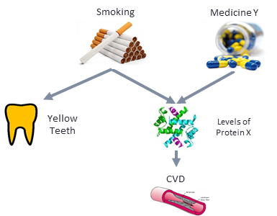
PC Algorithm – an example
1. Begin with the full graph.
Smoking
Medicine Y
Yellow
Teeth
Levels of Protein X
True (unknown) graph
CVD
Notes:
So let’s assume that we have measured these four variables, and some of the independencies that hold in the joint distribution are the independencies we see here next to the graph.

Slide 39
PC Algorithm – an example
2. k=0
Smoking
Medicine Y
Yellow
Teeth
Levels of Protein X
True (unknown) graph
CVD
Notes:
So let’s assume that we have measured these four variables, and some of the independencies that hold in the joint distribution are the independencies we see here next to the graph.

Slide 40
PC Algorithm – an example
2. k=0
Tests attempted | p-value
Yellow Teeth, Smoking | 0.00002
Smoking
Medicine Y
Yellow
Teeth
Levels of Protein X
True (unknown) graph
CVD
Notes:
So let’s assume that we have measured these four variables, and some of the independencies that hold in the joint distribution are the independencies we see here next to the graph.

Slide 41
PC Algorithm – an example
2. k=0
Tests attempted | p-value
Yellow Teeth, Smoking | 0.00002
Yellow Teeth, CVD | 0.00384
Smoking
Medicine Y
Yellow
Teeth
Levels of Protein X
True (unknown) graph
CVD
Notes:
So let’s assume that we have measured these four variables, and some of the independencies that hold in the joint distribution are the independencies we see here next to the graph.

Slide 42
PC Algorithm – an example
2. k=0
Tests attempted | p-value
Yellow Teeth, Smoking | 0.00002
Yellow Teeth, CVD | 0.00384
Yellow Teeth, Medicine Y | 0.54501
Smoking
Medicine Y
Yellow
Teeth
Levels of Protein X
True (unknown) graph
CVD
Notes:
So let’s assume that we have measured these four variables, and some of the independencies that hold in the joint distribution are the independencies we see here next to the graph.

Slide 43
PC Algorithm – an example
2. k=0
Tests attempted | p-value
Yellow Teeth, Smoking | 0.00002
Yellow Teeth, CVD | 0.00384
Yellow Teeth, Medicine Y | 0.54501
Yellow Teeth, Protein X | 0.00056
Smoking
Medicine Y
Yellow
Teeth
Levels of Protein X
True (unknown) graph
CVD
Notes:
So let’s assume that we have measured these four variables, and some of the independencies that hold in the joint distribution are the independencies we see here next to the graph.

Slide 44
PC Algorithm – an example
2. k=0
Tests attempted | p-value
Yellow Teeth, Smoking | 0.00002
Yellow Teeth, CVD | 0.00384
Yellow Teeth, Medicine Y | 0.54501
Yellow Teeth, Protein X | 0.00056
Smoking, CVD | 0.00015
Smoking
Medicine Y
Yellow
Teeth
Levels of Protein X
True (unknown) graph
CVD
Notes:
So let’s assume that we have measured these four variables, and some of the independencies that hold in the joint distribution are the independencies we see here next to the graph.

Slide 45
PC Algorithm – an example
2. k=0
Tests attempted | p-value
Yellow Teeth, Smoking | 0.00002
Yellow Teeth, CVD | 0.00384
Yellow Teeth, Medicine Y | 0.54501
Yellow Teeth, Protein X | 0.00056
Smoking, CVD | 0.00015
Smoking, Medicine Y | 0.36458
Smoking
Medicine Y
Yellow
Teeth
Levels of Protein X
True (unknown) graph
CVD
Notes:
So let’s assume that we have measured these four variables, and some of the independencies that hold in the joint distribution are the independencies we see here next to the graph.

Slide 46
PC Algorithm – an example
2. k=0
Tests attempted | p-value
Yellow Teeth, Smoking | 0.00002
Yellow Teeth, CVD | 0.00384
Yellow Teeth, Medicine Y | 0.54501
Yellow Teeth, Protein X | 0.00056
Smoking, CVD | 0.00015
Smoking, Medicine Y | 0.36458
Smoking, Protein X | 0.00003
Smoking
Medicine Y
Yellow
Teeth
Levels of Protein X
True (unknown) graph
CVD
Notes:
So let’s assume that we have measured these four variables, and some of the independencies that hold in the joint distribution are the independencies we see here next to the graph.

Slide 47
PC Algorithm – an example
2. k=0
Tests attempted | p-value
Yellow Teeth, Smoking | 0.00002
Yellow Teeth, CVD | 0.00384
Yellow Teeth, Medicine Y | 0.54501
Yellow Teeth, Protein X | 0.00056
Smoking, CVD | 0.00015
Smoking, Medicine Y | 0.36458
Smoking, Protein X | 0.00003
CVD, Medicine Y | 0.00012
Smoking
Medicine Y
Yellow
Teeth
Levels of Protein X
True (unknown) graph
CVD
Notes:
So let’s assume that we have measured these four variables, and some of the independencies that hold in the joint distribution are the independencies we see here next to the graph.

Slide 48
PC Algorithm – an example
2. k=0
Tests attempted | p-value
Yellow Teeth, Smoking | 0.00002
Yellow Teeth, CVD | 0.00384
Yellow Teeth, Medicine Y | 0.54501
Yellow Teeth, Protein X | 0.00056
Smoking, CVD | 0.00015
Smoking, Medicine Y | 0.36458
Smoking, Protein X | 0.00003
CVD, Medicine Y | 0.00012
CVD, Protein X | 0.00024
Smoking
Medicine Y
Yellow
Teeth
Levels of Protein X
True (unknown) graph
CVD
Notes:
So let’s assume that we have measured these four variables, and some of the independencies that hold in the joint distribution are the independencies we see here next to the graph.

Slide 49
PC Algorithm – an example
2. k=0
Tests attempted | p-value
Yellow Teeth, Smoking | 0.00002
Yellow Teeth, CVD | 0.00384
Yellow Teeth, Medicine Y | 0.54501
Yellow Teeth, Protein X | 0.00056
Smoking, CVD | 0.00015
Smoking, Medicine Y | 0.36458
Smoking, Protein X | 0.00003
CVD, Medicine Y | 0.00012
CVD, Protein X | 0.00024
Medicine Y, Protein X | 0.00007
Smoking
Medicine Y
Yellow
Teeth
Levels of Protein X
True (unknown) graph
CVD
Notes:
So let’s assume that we have measured these four variables, and some of the independencies that hold in the joint distribution are the independencies we see here next to the graph.

Slide 50
PC Algorithm – an example
2. k=1
Tests attempted | p-value
Yellow Teeth, Smoking | 0.00002
Yellow Teeth, CVD | 0.00384
Yellow Teeth, Medicine Y | 0.54501
Yellow Teeth, Protein X | 0.00056
Smoking, CVD | 0.00015
Smoking, Medicine Y | 0.36458
Smoking, Protein X | 0.00003
CVD, Medicine Y | 0.00012
CVD, Protein X | 0.00024
Medicine Y, Protein X | 0.00007
You want to identify the least correlated variables
Since all variables are binary, you can check the p-values (in decreasing order)
Smoking
Medicine Y
Yellow
Teeth
Levels of Protein X
True (unknown) graph
CVD
Notes:
So let’s assume that we have measured these four variables, and some of the independencies that hold in the joint distribution are the independencies we see here next to the graph.

Slide 51
PC Algorithm – an example
2. k=1
Tests attempted | p-value
Yellow Teeth, Smoking | 0.00002
Yellow Teeth, CVD | 0.00384
Yellow Teeth, Medicine Y | 0.54501
Yellow Teeth, Protein X | 0.00056
Smoking, CVD | 0.00015
Smoking, Medicine Y | 0.36458
Smoking, Protein X | 0.00003
CVD, Medicine Y | 0.00012
CVD, Protein X | 0.00024
Medicine Y, Protein X | 0.00007
Smoking
Medicine Y
Yellow
Teeth
Levels of Protein X
True (unknown) graph
CVD
Yellow Teeth, CVD are the least associated variables
Notes:
So let’s assume that we have measured these four variables, and some of the independencies that hold in the joint distribution are the independencies we see here next to the graph.

Slide 52
PC Algorithm – an example
2. k=1
Tests attempted | p-value
Yellow Teeth, Smoking | 0.00002
Yellow Teeth, CVD | 0.00384
Yellow Teeth, Medicine Y | 0.54501
Yellow Teeth, Protein X | 0.00056
Smoking, CVD | 0.00015
Smoking, Medicine Y | 0.36458
Smoking, Protein X | 0.00003
CVD, Medicine Y | 0.00012
CVD, Protein X | 0.00024
Medicine Y, Protein X | 0.00007
Smoking
Medicine Y
Yellow
Teeth
Levels of Protein X
True (unknown) graph
CVD
Yellow Teeth, CVD are the least associated variables
Adjacent(Yellow Teeth)\CVD = {Smoking, Protein X}
Notes:
So let’s assume that we have measured these four variables, and some of the independencies that hold in the joint distribution are the independencies we see here next to the graph.

Slide 53
PC Algorithm – an example
2. k=1
Tests attempted | p-value
Yellow Teeth, Smoking | 0.00002
Yellow Teeth, CVD | 0.00384
Yellow Teeth, Medicine Y | 0.54501
Yellow Teeth, Protein X | 0.00056
Smoking, CVD | 0.00015
Smoking, Medicine Y | 0.36458
Smoking, Protein X | 0.00003
CVD, Medicine Y | 0.00012
CVD, Protein X | 0.00024
Medicine Y, Protein X | 0.00007
Smoking
Medicine Y
Yellow
Teeth
Levels of Protein X
True (unknown) graph
CVD
Yellow Teeth, CVD are the least associated variables
Adjacent(Yellow Teeth)\CVD = {Smoking, Protein X}
Yellow Teeth, Smoking are the most associated variables
Notes:
So let’s assume that we have measured these four variables, and some of the independencies that hold in the joint distribution are the independencies we see here next to the graph.

Slide 54
PC Algorithm – an example
2. k=1
Tests attempted | p-value
Yellow Teeth, Smoking | 0.00002
Yellow Teeth, CVD | 0.00384
Yellow Teeth, Medicine Y | 0.54501
Yellow Teeth, Protein X | 0.00056
Smoking, CVD | 0.00015
Smoking, Medicine Y | 0.36458
Smoking, Protein X | 0.00003
CVD, Medicine Y | 0.00012
CVD, Protein X | 0.00024
Medicine Y, Protein X | 0.00007
Tests attempted | p-value
Yellow Teeth, CVD| Smoking | 0.78961
Smoking
Medicine Y
Yellow
Teeth
Levels of Protein X
True (unknown) graph
CVD
Yellow Teeth, CVD are the least associated variables
Adjacent(Yellow Teeth)\CVD = {Smoking, Protein X}
Yellow Teeth, Smoking are the most associated variables
Notes:
So let’s assume that we have measured these four variables, and some of the independencies that hold in the joint distribution are the independencies we see here next to the graph.

Slide 55
PC Algorithm – an example
2. k=1
Tests attempted | p-value
Yellow Teeth, Smoking | 0.00002
Yellow Teeth, CVD | 0.00384
Yellow Teeth, Medicine Y | 0.54501
Yellow Teeth, Protein X | 0.00056
Smoking, CVD | 0.00035
Smoking, Medicine Y | 0.36458
Smoking, Protein X | 0.00003
CVD, Medicine Y | 0.00062
CVD, Protein X | 0.00014
Medicine Y, Protein X | 0.00007
Tests attempted | p-value
Yellow Teeth, CVD| Smoking | 0.78961
Smoking
Medicine Y
Yellow
Teeth
Levels of Protein X
True (unknown) graph
CVD
CVD, Medicine Y are the least associated variables
Adjacent(CVD)\Medicine Y = {Smoking, Protein X}
CVD, Protein X are the most associated variables
Notes:
So let’s assume that we have measured these four variables, and some of the independencies that hold in the joint distribution are the independencies we see here next to the graph.

Slide 56
PC Algorithm – an example
2. k=1
Tests attempted | p-value
Yellow Teeth, Smoking | 0.00002
Yellow Teeth, CVD | 0.00384
Yellow Teeth, Medicine Y | 0.54501
Yellow Teeth, Protein X | 0.00056
Smoking, CVD | 0.00035
Smoking, Medicine Y | 0.36458
Smoking, Protein X | 0.00003
CVD, Medicine Y | 0.00062
CVD, Protein X | 0.00014
Medicine Y, Protein X | 0.00007
Tests attempted | p-value
Yellow Teeth, CVD| Smoking | 0.78961
CVD, Medicine Y | Protein X | 0.15092
Smoking
Medicine Y
Yellow
Teeth
Levels of Protein X
True (unknown) graph
CVD
CVD, Medicine Y are the least associated variables
Adjacent(CVD)\Medicine Y = {Smoking, Protein X}
CVD, Protein X are the most associated variables
Notes:
So let’s assume that we have measured these four variables, and some of the independencies that hold in the joint distribution are the independencies we see here next to the graph.

Slide 57
PC Algorithm – an example
2. k=1
Tests attempted | p-value
Yellow Teeth, Smoking | 0.00002
Yellow Teeth, CVD | 0.00384
Yellow Teeth, Medicine Y | 0.54501
Yellow Teeth, Protein X | 0.00056
Smoking, CVD | 0.00035
Smoking, Medicine Y | 0.36458
Smoking, Protein X | 0.00003
CVD, Medicine Y | 0.00062
CVD, Protein X | 0.00014
Medicine Y, Protein X | 0.00007
Tests attempted | p-value
Yellow Teeth, CVD| Smoking | 0.78961
CVD, Medicine Y | Protein X | 0.15092
Smoking
Medicine Y
Yellow
Teeth
Levels of Protein X
True (unknown) graph
CVD
Yellow Teeth, Protein X are the least associated variables
Adjacent(Yellow Teeth)\Protein X = {Smoking}
Notes:
So let’s assume that we have measured these four variables, and some of the independencies that hold in the joint distribution are the independencies we see here next to the graph.

Slide 58
PC Algorithm – an example
2. k=1
Tests attempted | p-value
Yellow Teeth, Smoking | 0.00002
Yellow Teeth, CVD | 0.00384
Yellow Teeth, Medicine Y | 0.54501
Yellow Teeth, Protein X | 0.00056
Smoking, CVD | 0.00035
Smoking, Medicine Y | 0.36458
Smoking, Protein X | 0.00003
CVD, Medicine Y | 0.00062
CVD, Protein X | 0.00014
Medicine Y, Protein X | 0.00007
Tests attempted | p-value
Yellow Teeth, CVD| Smoking | 0.78961
CVD, Medicine Y | Protein X | 0.15092
Yellow Teeth, Protein X | Smoking | 0.23567
Smoking
Medicine Y
Yellow
Teeth
Levels of Protein X
True (unknown) graph
CVD
Yellow Teeth, Protein X are the least associated variables
Adjacent(Yellow Teeth)\Protein X = {Smoking}
Notes:
So let’s assume that we have measured these four variables, and some of the independencies that hold in the joint distribution are the independencies we see here next to the graph.

Slide 59
PC Algorithm – an example
2. k=1
Tests attempted | p-value
Yellow Teeth, Smoking | 0.00002
Yellow Teeth, CVD | 0.00384
Yellow Teeth, Medicine Y | 0.54501
Yellow Teeth, Protein X | 0.00056
Smoking, CVD | 0.00035
Smoking, Medicine Y | 0.36458
Smoking, Protein X | 0.00003
CVD, Medicine Y | 0.00062
CVD, Protein X | 0.00014
Medicine Y, Protein X | 0.00007
Tests attempted | p-value
Yellow Teeth, CVD| Smoking | 0.78961
CVD, Medicine Y | Protein X | 0.15092
Yellow Teeth, Protein X | Smoking | 0.23567
Smoking
Medicine Y
Yellow
Teeth
Levels of Protein X
True (unknown) graph
CVD
Smoking, CVD are the least associated variables
Adjacent(Smoking)\CVD= {Yellow Teeth, Protein X}
Smoking, Yellow Teeth are the most associated variables
Notes:
So let’s assume that we have measured these four variables, and some of the independencies that hold in the joint distribution are the independencies we see here next to the graph.

Slide 60
PC Algorithm – an example
2. k=1
Tests attempted | p-value
Yellow Teeth, Smoking | 0.00002
Yellow Teeth, CVD | 0.00384
Yellow Teeth, Medicine Y | 0.54501
Yellow Teeth, Protein X | 0.00056
Smoking, CVD | 0.00035
Smoking, Medicine Y | 0.36458
Smoking, Protein X | 0.00003
CVD, Medicine Y | 0.00062
CVD, Protein X | 0.00014
Medicine Y, Protein X | 0.00007
Tests attempted | p-value
Yellow Teeth, CVD| Smoking | 0.78961
CVD, Medicine Y | Protein X | 0.15092
Yellow Teeth, Protein X | Smoking | 0.23567
Smoking, CVD |Yellow Teeth | 0.00345
Smoking
Medicine Y
Yellow
Teeth
Levels of Protein X
True (unknown) graph
CVD
Smoking, CVD are the least associated variables
Adjacent(Smoking)\CVD= {Yellow Teeth, Protein X}
Smoking, Yellow Teeth are the most associated variables
Notes:
So let’s assume that we have measured these four variables, and some of the independencies that hold in the joint distribution are the independencies we see here next to the graph.

Slide 61
PC Algorithm – an example
2. k=1
Tests attempted | p-value
Yellow Teeth, Smoking | 0.00002
Yellow Teeth, CVD | 0.00384
Yellow Teeth, Medicine Y | 0.54501
Yellow Teeth, Protein X | 0.00056
Smoking, CVD | 0.00035
Smoking, Medicine Y | 0.36458
Smoking, Protein X | 0.00003
CVD, Medicine Y | 0.00062
CVD, Protein X | 0.00014
Medicine Y, Protein X | 0.00007
Tests attempted | p-value
Yellow Teeth, CVD| Smoking | 0.78961
CVD, Medicine Y | Protein X | 0.15092
Yellow Teeth, Protein X | Smoking | 0.23567
Smoking, CVD |Yellow Teeth | 0.00345
Smoking, CVD | Protein X | 0.12365
Smoking
Medicine Y
Yellow
Teeth
Levels of Protein X
True (unknown) graph
CVD
Smoking, CVD are the least associated variables
Adjacent(Smoking)\CVD= {Yellow Teeth, Protein X}
Smoking, Protein X are the next most associated variables
Notes:
So let’s assume that we have measured these four variables, and some of the independencies that hold in the joint distribution are the independencies we see here next to the graph.

Slide 62
PC Algorithm – an example
2. k=1
Tests attempted | p-value
Yellow Teeth, Smoking | 0.00002
Yellow Teeth, CVD | 0.00384
Yellow Teeth, Medicine Y | 0.54501
Yellow Teeth, Protein X | 0.00056
Smoking, CVD | 0.00035
Smoking, Medicine Y | 0.36458
Smoking, Protein X | 0.00003
CVD, Medicine Y | 0.00062
CVD, Protein X | 0.00014
Medicine Y, Protein X | 0.00007
Tests attempted | p-value
Yellow Teeth, CVD| Smoking | 0.78961
CVD, Medicine Y | Protein X | 0.15092
Yellow Teeth, Protein X | Smoking | 0.23567
Smoking, CVD |Yellow Teeth | 0.00345
Smoking, CVD | Protein X | 0.12365
Smoking
Medicine Y
Yellow
Teeth
Levels of Protein X
True (unknown) graph
CVD
CVD, Protein X are the least associated variables
Adjacent(CVD)\Protein X = {}
Notes:
So let’s assume that we have measured these four variables, and some of the independencies that hold in the joint distribution are the independencies we see here next to the graph.

Slide 63
PC Algorithm – an example
2. k=1
Tests attempted | p-value
Yellow Teeth, Smoking | 0.00002
Yellow Teeth, CVD | 0.00384
Yellow Teeth, Medicine Y | 0.54501
Yellow Teeth, Protein X | 0.00056
Smoking, CVD | 0.00035
Smoking, Medicine Y | 0.36458
Smoking, Protein X | 0.00003
CVD, Medicine Y | 0.00062
CVD, Protein X | 0.00014
Medicine Y, Protein X | 0.00007
Tests attempted | p-value
Yellow Teeth, CVD| Smoking | 0.78961
CVD, Medicine Y | Protein X | 0.15092
Yellow Teeth, Protein X | Smoking | 0.23567
Smoking, CVD |Yellow Teeth | 0.00345
Smoking, CVD | Protein X | 0.12365
Smoking
Medicine Y
Yellow
Teeth
Levels of Protein X
True (unknown) graph
CVD
CVD, Protein X are the least associated variables
Adjacent(Protein X)\CVD= {Smoking, Medicine Y}
Notes:
So let’s assume that we have measured these four variables, and some of the independencies that hold in the joint distribution are the independencies we see here next to the graph.

Slide 64
PC Algorithm – an example
2. k=1
Tests attempted | p-value
Yellow Teeth, Smoking | 0.00002
Yellow Teeth, CVD | 0.00384
Yellow Teeth, Medicine Y | 0.54501
Yellow Teeth, Protein X | 0.00056
Smoking, CVD | 0.00035
Smoking, Medicine Y | 0.36458
Smoking, Protein X | 0.00003
CVD, Medicine Y | 0.00062
CVD, Protein X | 0.00014
Medicine Y, Protein X | 0.00007
Tests attempted | p-value
Yellow Teeth, CVD| Smoking | 0.78961
CVD, Medicine Y | Protein X | 0.15092
Yellow Teeth, Protein X | Smoking | 0.23567
Smoking, CVD |Yellow Teeth | 0.00345
Smoking, CVD | Protein X | 0.12365
CVD, Protein X | Smoking | 0.00045
Smoking
Medicine Y
Yellow
Teeth
Levels of Protein X
True (unknown) graph
CVD
CVD, Protein X are the least associated variables
Adjacent(Protein X)\CVD= {Smoking, Medicine Y}
Protein X, Smoking are the most associated variables
Notes:
So let’s assume that we have measured these four variables, and some of the independencies that hold in the joint distribution are the independencies we see here next to the graph.

Slide 65
PC Algorithm – an example
2. k=1
Tests attempted | p-value
Yellow Teeth, Smoking | 0.00002
Yellow Teeth, CVD | 0.00384
Yellow Teeth, Medicine Y | 0.54501
Yellow Teeth, Protein X | 0.00056
Smoking, CVD | 0.00035
Smoking, Medicine Y | 0.36458
Smoking, Protein X | 0.00003
CVD, Medicine Y | 0.00062
CVD, Protein X | 0.00014
Medicine Y, Protein X | 0.00007
Tests attempted | p-value
Yellow Teeth, CVD| Smoking | 0.78961
CVD, Medicine Y | Protein X | 0.15092
Yellow Teeth, Protein X | Smoking | 0.23567
Smoking, CVD |Yellow Teeth | 0.00345
Smoking, CVD | Protein X | 0.12365
CVD, Protein X | Smoking | 0.00045
CVD, Protein X | Medicine Y | 0.00389
Smoking
Medicine Y
Yellow
Teeth
Levels of Protein X
True (unknown) graph
CVD
CVD, Protein X are the least associated variables
Adjacent(Protein X)\CVD= {Smoking, Medicine Y}
Protein X, Medicine Y are the next most associated variables
Notes:
So let’s assume that we have measured these four variables, and some of the independencies that hold in the joint distribution are the independencies we see here next to the graph.

Slide 66
PC Algorithm – an example
2. k=1
Tests attempted | p-value
Yellow Teeth, Smoking | 0.00002
Yellow Teeth, CVD | 0.00384
Yellow Teeth, Medicine Y | 0.54501
Yellow Teeth, Protein X | 0.00056
Smoking, CVD | 0.00035
Smoking, Medicine Y | 0.36458
Smoking, Protein X | 0.00003
CVD, Medicine Y | 0.00062
CVD, Protein X | 0.00014
Medicine Y, Protein X | 0.00007
Tests attempted | p-value
Yellow Teeth, CVD| Smoking | 0.78961
CVD, Medicine Y | Protein X | 0.15092
Yellow Teeth, Protein X | Smoking | 0.23567
Smoking, CVD |Yellow Teeth | 0.00345
Smoking, CVD | Protein X | 0.12365
CVD, Protein X | Smoking | 0.00045
CVD, Protein X | Medicine Y | 0.00389
Medicine Y, Protein X|CVD | 0.00972
Smoking, Protein X | Yellow Teeth | 0.00126
Smoking, Protein X|CVD | 0.00438
Yellow Teeth, Smoking|Protein X | 0.00072
Smoking
Medicine Y
Yellow
Teeth
Levels of Protein X
True (unknown) graph
CVD
…
Notes:
So let’s assume that we have measured these four variables, and some of the independencies that hold in the joint distribution are the independencies we see here next to the graph.

Slide 67
PC Algorithm – an example
2. k=2
Tests attempted | p-value
Yellow Teeth, Smoking | 0.00002
Yellow Teeth, CVD | 0.00384
Yellow Teeth, Medicine Y | 0.54501
Yellow Teeth, Protein X | 0.00056
Smoking, CVD | 0.00035
Smoking, Medicine Y | 0.36458
Smoking, Protein X | 0.00003
CVD, Medicine Y | 0.00062
CVD, Protein X | 0.00014
Medicine Y, Protein X | 0.00007
Tests attempted | p-value
Yellow Teeth, CVD| Smoking | 0.78961
CVD, Medicine Y | Protein X | 0.15092
Yellow Teeth, Protein X | Smoking | 0.23567
Smoking, CVD |Yellow Teeth | 0.00345
Smoking, CVD | Protein X | 0.12365
CVD, Protein X | Smoking | 0.00045
CVD, Protein X | Medicine Y | 0.00389
Medicine Y, Protein X|CVD | 0.00972
Smoking, Protein X | Yellow Teeth | 0.00126
Smoking, Protein X|CVD | 0.00438
Yellow Teeth, Smoking|Protein X | 0.00072
Smoking
Medicine Y
Yellow
Teeth
Levels of Protein X
True (unknown) graph
CVD
Only Protein X has two neighbors.
Notes:
So let’s assume that we have measured these four variables, and some of the independencies that hold in the joint distribution are the independencies we see here next to the graph.

Slide 68
PC Algorithm – an example
2. k=2
Tests attempted | p-value
Yellow Teeth, Smoking | 0.00002
Yellow Teeth, CVD | 0.00384
Yellow Teeth, Medicine Y | 0.54501
Yellow Teeth, Protein X | 0.00056
Smoking, CVD | 0.00035
Smoking, Medicine Y | 0.36458
Smoking, Protein X | 0.00003
CVD, Medicine Y | 0.00062
CVD, Protein X | 0.00014
Medicine Y, Protein X | 0.00007
Tests attempted | p-value
Yellow Teeth, CVD| Smoking | 0.78961
CVD, Medicine Y | Protein X | 0.15092
Yellow Teeth, Protein X | Smoking | 0.23567
Smoking, CVD |Yellow Teeth | 0.00345
Smoking, CVD | Protein X | 0.12365
CVD, Protein X | Smoking | 0.00045
CVD, Protein X | Medicine Y | 0.00389
Medicine Y, Protein X|CVD | 0.00972
Smoking, Protein X | Yellow Teeth | 0.00126
Smoking, Protein X|CVD | 0.00438
Yellow Teeth, Smoking|Protein X | 0.00072
Smoking
Medicine Y
Yellow
Teeth
Levels of Protein X
True (unknown) graph
CVD
Tests attempted | p-value
CVD, Protein X| Smoking, Medicine Y | 0.02356
Smoking, Protein X|CVD, Medicine Y | 0.00498
Medicine Y, Protein X| Smoking, CVD | 0.00074
Only Protein X has two neighbors
Notes:
So let’s assume that we have measured these four variables, and some of the independencies that hold in the joint distribution are the independencies we see here next to the graph.

Slide 69
PC Algorithm – an example
2. k=3
Tests attempted | p-value
Yellow Teeth, Smoking | 0.00002
Yellow Teeth, CVD | 0.00384
Yellow Teeth, Medicine Y | 0.54501
Yellow Teeth, Protein X | 0.00056
Smoking, CVD | 0.00035
Smoking, Medicine Y | 0.36458
Smoking, Protein X | 0.00003
CVD, Medicine Y | 0.00062
CVD, Protein X | 0.00014
Medicine Y, Protein X | 0.00007
Tests attempted | p-value
Yellow Teeth, CVD| Smoking | 0.78961
CVD, Medicine Y | Protein X | 0.15092
Yellow Teeth, Protein X | Smoking | 0.23567
Smoking, CVD |Yellow Teeth | 0.00345
Smoking, CVD | Protein X | 0.12365
CVD, Protein X | Smoking | 0.00045
CVD, Protein X | Medicine Y | 0.00389
Medicine Y, Protein X|CVD | 0.00972
Smoking, Protein X | Yellow Teeth | 0.00126
Smoking, Protein X|CVD | 0.00438
Yellow Teeth, Smoking|Protein X | 0.00072
Smoking
Medicine Y
Yellow
Teeth
Levels of Protein X
True (unknown) graph
CVD
Tests attempted | p-value
CVD, Protein X| Smoking, Medicine Y | 0.02356
Smoking, Protein X|CVD, Medicine Y | 0.00498
Medicine Y, Protein X| Smoking, CVD | 0.00074
No variable has four neighbors.
Notes:
So let’s assume that we have measured these four variables, and some of the independencies that hold in the joint distribution are the independencies we see here next to the graph.

Slide 70
PC Algorithm – an example
No more edges can be removed.
Tests attempted | p-value
Yellow Teeth, Smoking | 0.00002
Yellow Teeth, CVD | 0.00384
Yellow Teeth, Medicine Y | 0.54501
Yellow Teeth, Protein X | 0.00056
Smoking, CVD | 0.00035
Smoking, Medicine Y | 0.36458
Smoking, Protein X | 0.00003
CVD, Medicine Y | 0.00062
CVD, Protein X | 0.00014
Medicine Y, Protein X | 0.00007
Tests attempted | p-value
Yellow Teeth, CVD| Smoking | 0.78961
CVD, Medicine Y | Protein X | 0.15092
Yellow Teeth, Protein X | Smoking | 0.23567
Smoking, CVD |Yellow Teeth | 0.00345
Smoking, CVD | Protein X | 0.12365
CVD, Protein X | Smoking | 0.00045
CVD, Protein X | Medicine Y | 0.00389
Medicine Y, Protein X|CVD | 0.00972
Smoking, Protein X | Yellow Teeth | 0.00126
Smoking, Protein X|CVD | 0.00438
Yellow Teeth, Smoking|Protein X | 0.00072
Smoking
Medicine Y
Yellow
Teeth
Levels of Protein X
True (unknown) graph
CVD
Tests attempted | p-value
CVD, Protein X| Smoking, Medicine Y | 0.02356
Smoking, Protein X|CVD, Medicine Y | 0.00498
Medicine Y, Protein X| Smoking, CVD | 0.00074
You have (correctly) identified the skeleton of your graph
For causal discovery, you also want to identify some edge directions!
Notes:
So let’s assume that we have measured these four variables, and some of the independencies that hold in the joint distribution are the independencies we see here next to the graph.

Slide 71
PC Algorithm – an example
Smoking and Medicine Y are independent given the empty set.
Tests attempted | p-value
Yellow Teeth, Smoking | 0.00002
Yellow Teeth, CVD | 0.00384
Yellow Teeth, Medicine Y | 0.54501
Yellow Teeth, Protein X | 0.00056
Smoking, CVD | 0.00035
Smoking, Medicine Y | 0.36458
Smoking, Protein X | 0.00003
CVD, Medicine Y | 0.00062
CVD, Protein X | 0.00014
Medicine Y, Protein X | 0.00007
Tests attempted | p-value
Yellow Teeth, CVD| Smoking | 0.78961
CVD, Medicine Y | Protein X | 0.15092
Yellow Teeth, Protein X | Smoking | 0.23567
Smoking, CVD |Yellow Teeth | 0.00345
Smoking, CVD | Protein X | 0.12365
CVD, Protein X | Smoking | 0.00045
CVD, Protein X | Medicine Y | 0.00389
Medicine Y, Protein X|CVD | 0.00972
Smoking, Protein X | Yellow Teeth | 0.00126
Smoking, Protein X|CVD | 0.00438
Yellow Teeth, Smoking|Protein X | 0.00072
Smoking
Medicine Y
Yellow
Teeth
Levels of Protein X
True (unknown) graph
CVD
Tests attempted | p-value
CVD, Protein X| Smoking, Medicine Y | 0.02356
Smoking, Protein X|CVD, Medicine Y | 0.00498
Medicine Y, Protein X| Smoking, CVD | 0.00074
If Levels of Protein X was a non-collider on the path Smoking – Protein X – Medicine Y the path would be d-connecting given the empty set
Notes:
So let’s assume that we have measured these four variables, and some of the independencies that hold in the joint distribution are the independencies we see here next to the graph.

Slide 72


PC Algorithm – an example
Smoking and Medicine Y are independent given the empty set.
Tests attempted | p-value
Yellow Teeth, Smoking | 0.00002
Yellow Teeth, CVD | 0.00384
Yellow Teeth, Medicine Y | 0.54501
Yellow Teeth, Protein X | 0.00056
Smoking, CVD | 0.00035
Smoking, Medicine Y | 0.36458
Smoking, Protein X | 0.00003
CVD, Medicine Y | 0.00062
CVD, Protein X | 0.00014
Medicine Y, Protein X | 0.00007
Tests attempted | p-value
Yellow Teeth, CVD| Smoking | 0.78961
CVD, Medicine Y | Protein X | 0.15092
Yellow Teeth, Protein X | Smoking | 0.23567
Smoking, CVD |Yellow Teeth | 0.00345
Smoking, CVD | Protein X | 0.12365
CVD, Protein X | Smoking | 0.00045
CVD, Protein X | Medicine Y | 0.00389
Medicine Y, Protein X|CVD | 0.00972
Smoking, Protein X | Yellow Teeth | 0.00126
Smoking, Protein X|CVD | 0.00438
Yellow Teeth, Smoking|Protein X | 0.00072
Smoking
Medicine Y
Yellow
Teeth
Levels of Protein X
True (unknown) graph
CVD
Tests attempted | p-value
CVD, Protein X| Smoking, Medicine Y | 0.02356
Smoking, Protein X|CVD, Medicine Y | 0.00498
Medicine Y, Protein X| Smoking, CVD | 0.00074
You would expect a dependence
$$∅$$
Smoking $∦$ Medicine Y |
(i.e. a p-value < 0.05)
Notes:
So let’s assume that we have measured these four variables, and some of the independencies that hold in the joint distribution are the independencies we see here next to the graph.

Slide 73
PC Algorithm – an example
Smoking and Medicine Y are independent given the empty set.
Tests attempted | p-value
Yellow Teeth, Smoking | 0.00002
Yellow Teeth, CVD | 0.00384
Yellow Teeth, Medicine Y | 0.54501
Yellow Teeth, Protein X | 0.00056
Smoking, CVD | 0.00035
Smoking, Medicine Y | 0.36458
Smoking, Protein X | 0.00003
CVD, Medicine Y | 0.00062
CVD, Protein X | 0.00014
Medicine Y, Protein X | 0.00007
Tests attempted | p-value
Yellow Teeth, CVD| Smoking | 0.78961
CVD, Medicine Y | Protein X | 0.15092
Yellow Teeth, Protein X | Smoking | 0.23567
Smoking, CVD |Yellow Teeth | 0.00345
Smoking, CVD | Protein X | 0.12365
CVD, Protein X | Smoking | 0.00045
CVD, Protein X | Medicine Y | 0.00389
Medicine Y, Protein X|CVD | 0.00972
Smoking, Protein X | Yellow Teeth | 0.00126
Smoking, Protein X|CVD | 0.00438
Yellow Teeth, Smoking|Protein X | 0.00072
Smoking
Medicine Y
Yellow
Teeth
Levels of Protein X
True (unknown) graph
CVD
Tests attempted | p-value
CVD, Protein X| Smoking, Medicine Y | 0.02356
Smoking, Protein X|CVD, Medicine Y | 0.00498
Medicine Y, Protein X| Smoking, CVD | 0.00074
Thus, the triple must be a collider!
Notes:
So let’s assume that we have measured these four variables, and some of the independencies that hold in the joint distribution are the independencies we see here next to the graph.

Slide 74





Unshielded colliders in CBNs
Causal Bayesian Network describing your variables
Y
Y
Y
Y
X
Z
X
Z
X
Z
X
Z
Independencies entailed by the CMC
$\text{X}∥\text{Z}$|{$…\}$
$\text{X}∥\text{Z}$|{Y$…\}$
$\text{X}∥\text{Z}$|{Y$…\}$
$\text{X}∥\text{Z}$|{Y$…\}$
$\text{X}∦\text{Z}$|{Y…}
Could be connected by another path, but not an edge
You DON’T need Y to d-separate X and Z
You need Y to d-separate X and Z
In fact, conditioning on Y would make X, Z dependent

Slide 75
Unshielded colliders in CBNs
Causal Bayesian Network describing your variables
Y
Y
Y
Y
X
Z
X
Z
X
Z
X
Z
Independencies entailed by the CMC
$\text{X}∥\text{Z}$|{$…\}$
$\text{X}∥\text{Z}$|{Y$…\}$
$\text{X}∥\text{Z}$|{Y$…\}$
$\text{X}∥\text{Z}$|{Y$…\}$
$\text{X}∦\text{Z}$|{Y…}
Could be connected by another path, but not an edge
You DON’T need Y to d-separate X and Z
You need Y to d-separate X and Z
In fact, conditioning on Y would make X, Z dependent
if X-Z-Y form an unshielded triplet, you can distinguish whether the triplet is a collider or a non-collider.

Slide 76
Orientation rules
B
If C is NOT in the d-separating set of A, B
B
R0.
C
C
Orient Unshielded Colliders
A
A
B
If C is in the d-separating set of A, B
B
R1.
C
C
Away from collider
A
A

Slide 77
Orientation rules
B
B
R2.
C
C
Away from cycles
A
A
B
B
D
C
D
Double triangle
R3.
C
A
A

Slide 78
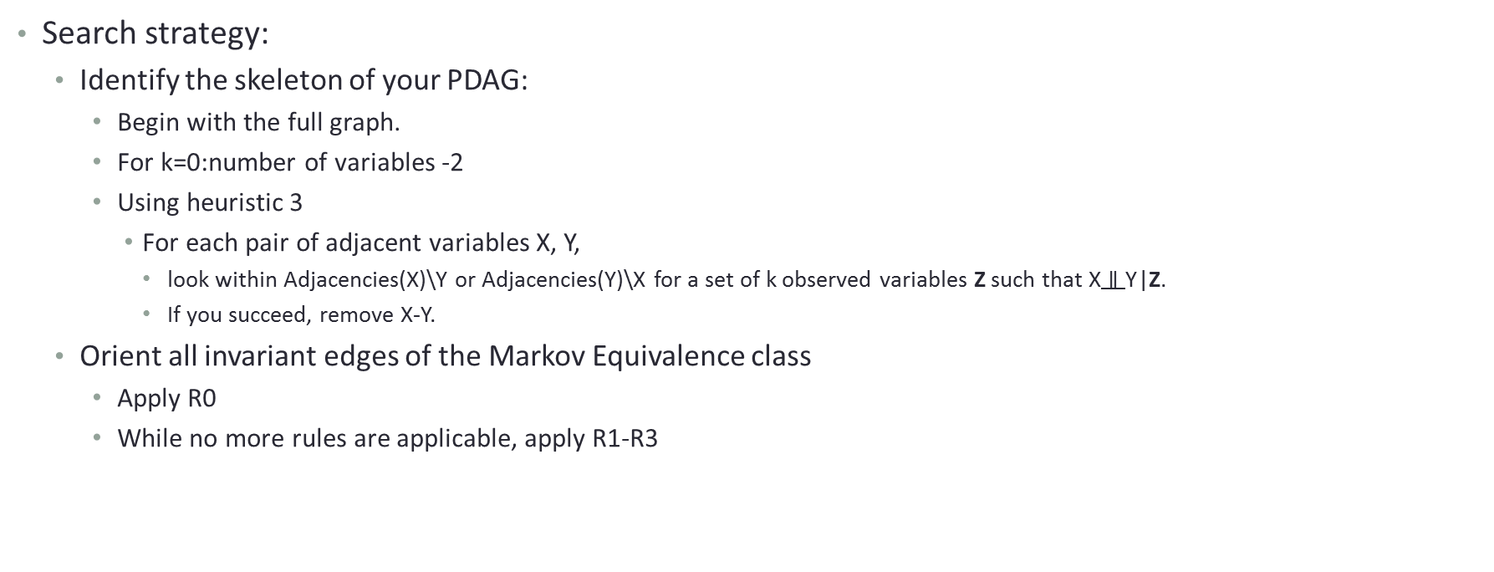
The PC algorithm
Search strategy:
Identify the skeleton of your PDAG:
Begin with the full graph.
For k=0:number of variables -2
Using heuristic 3
For each pair of adjacent variables X, Y,
look within Adjacencies(X)\Y or Adjacencies(Y)\X for a set of k observed variables Z such that $\text{X}∥\text{Y}$|Z.
If you succeed, remove X-Y.
Orient all invariant edges of the Markov Equivalence class
Apply R0
While no more rules are applicable, apply R1-R3
Rules R0-R3 are complete (Meek, 1995)

Slide 79
PC Algorithm – an example
Apply orientation rules
Tests attempted | p-value
Yellow Teeth, Smoking | 0.00002
Yellow Teeth, CVD | 0.00384
Yellow Teeth, Medicine Y | 0.54501
Yellow Teeth, Protein X | 0.00056
Smoking, CVD | 0.00035
Smoking, Medicine Y | 0.36458
Smoking, Protein X | 0.00003
CVD, Medicine Y | 0.00062
CVD, Protein X | 0.00014
Medicine Y, Protein X | 0.00007
Tests attempted | p-value
Yellow Teeth, CVD| Smoking | 0.78961
CVD, Medicine Y | Protein X | 0.15092
Yellow Teeth, Protein X | Smoking | 0.23567
Smoking, CVD |Yellow Teeth | 0.00345
Smoking, CVD | Protein X | 0.12365
CVD, Protein X | Smoking | 0.00045
CVD, Protein X | Medicine Y | 0.00389
Smoking
Medicine Y
Yellow
Teeth
Levels of Protein X
True (unknown) graph
CVD
Tests attempted | p-value
CVD, Protein X| Smoking, Medicine Y | 0.02356
Smoking, Protein X|CVD, Medicine Y | 0.00498
Medicine Y, Protein X| Smoking, CVD | 0.00074
Notes:
So let’s assume that we have measured these four variables, and some of the independencies that hold in the joint distribution are the independencies we see here next to the graph.

Slide 80
PC Algorithm – an example
Apply orientation rules
Tests attempted | p-value
Yellow Teeth, Smoking | 0.00002
Yellow Teeth, CVD | 0.00384
Yellow Teeth, Medicine Y | 0.54501
Yellow Teeth, Protein X | 0.00056
Smoking, CVD | 0.00035
Smoking, Medicine Y | 0.36458
Smoking, Protein X | 0.00003
CVD, Medicine Y | 0.00062
CVD, Protein X | 0.00014
Medicine Y, Protein X | 0.00007
Tests attempted | p-value
Yellow Teeth, CVD| Smoking | 0.78961
CVD, Medicine Y | Protein X | 0.15092
Yellow Teeth, Protein X | Smoking | 0.23567
Smoking, CVD |Yellow Teeth | 0.00345
Smoking, CVD | Protein X | 0.12365
CVD, Protein X | Smoking | 0.00045
CVD, Protein X | Medicine Y | 0.00389
Smoking
Medicine Y
Yellow
Teeth
Levels of Protein X
True (unknown) graph
CVD
Tests attempted | p-value
CVD, Protein X| Smoking, Medicine Y | 0.02356
Smoking, Protein X|CVD, Medicine Y | 0.00498
Medicine Y, Protein X| Smoking, CVD | 0.00074
Orient unshielded colliders
Smoking-Protein X-Medicine Y is a collider
Notes:
So let’s assume that we have measured these four variables, and some of the independencies that hold in the joint distribution are the independencies we see here next to the graph.

Slide 81
PC Algorithm – an example
Apply orientation rules
Tests attempted | p-value
Yellow Teeth, Smoking | 0.00002
Yellow Teeth, CVD | 0.00384
Yellow Teeth, Medicine Y | 0.54501
Yellow Teeth, Protein X | 0.00056
Smoking, CVD | 0.00035
Smoking, Medicine Y | 0.36458
Smoking, Protein X | 0.00003
CVD, Medicine Y | 0.00062
CVD, Protein X | 0.00014
Medicine Y, Protein X | 0.00007
Tests attempted | p-value
Yellow Teeth, CVD| Smoking | 0.78961
CVD, Medicine Y | Protein X | 0.15092
Yellow Teeth, Protein X | Smoking | 0.23567
Smoking, CVD |Yellow Teeth | 0.00345
Smoking, CVD | Protein X | 0.12365
CVD, Protein X | Smoking | 0.00045
CVD, Protein X | Medicine Y | 0.00389
Smoking
Medicine Y
Yellow
Teeth
Levels of Protein X
True (unknown) graph
CVD
Tests attempted | p-value
CVD, Protein X| Smoking, Medicine Y | 0.02356
Smoking, Protein X|CVD, Medicine Y | 0.00498
Medicine Y, Protein X| Smoking, CVD | 0.00074
Orient unshielded colliders
Yellow Teeth-Smoking-Protein X is a non collider
Notes:
So let’s assume that we have measured these four variables, and some of the independencies that hold in the joint distribution are the independencies we see here next to the graph.

Slide 82
PC Algorithm – an example
Apply orientation rules
Tests attempted | p-value
Yellow Teeth, Smoking | 0.00002
Yellow Teeth, CVD | 0.00384
Yellow Teeth, Medicine Y | 0.54501
Yellow Teeth, Protein X | 0.00056
Smoking, CVD | 0.00035
Smoking, Medicine Y | 0.36458
Smoking, Protein X | 0.00003
CVD, Medicine Y | 0.00062
CVD, Protein X | 0.00014
Medicine Y, Protein X | 0.00007
Tests attempted | p-value
Yellow Teeth, CVD| Smoking | 0.78961
CVD, Medicine Y | Protein X | 0.15092
Yellow Teeth, Protein X | Smoking | 0.23567
Smoking, CVD |Yellow Teeth | 0.00345
Smoking, CVD | Protein X | 0.12365
CVD, Protein X | Smoking | 0.00045
CVD, Protein X | Medicine Y | 0.00389
Smoking
Medicine Y
Yellow
Teeth
Levels of Protein X
True (unknown) graph
CVD
Tests attempted | p-value
CVD, Protein X| Smoking, Medicine Y | 0.02356
Smoking, Protein X|CVD, Medicine Y | 0.00498
Medicine Y, Protein X| Smoking, CVD | 0.00074
Orient unshielded colliders
Smoking-Protein X- CVD is a non collider
Notes:
So let’s assume that we have measured these four variables, and some of the independencies that hold in the joint distribution are the independencies we see here next to the graph.

Slide 83
PC Algorithm – an example
Apply orientation rules
Tests attempted | p-value
Yellow Teeth, Smoking | 0.00002
Yellow Teeth, CVD | 0.00384
Yellow Teeth, Medicine Y | 0.54501
Yellow Teeth, Protein X | 0.00056
Smoking, CVD | 0.00035
Smoking, Medicine Y | 0.36458
Smoking, Protein X | 0.00003
CVD, Medicine Y | 0.00062
CVD, Protein X | 0.00014
Medicine Y, Protein X | 0.00007
Tests attempted | p-value
Yellow Teeth, CVD| Smoking | 0.78961
CVD, Medicine Y | Protein X | 0.15092
Yellow Teeth, Protein X | Smoking | 0.23567
Smoking, CVD |Yellow Teeth | 0.00345
Smoking, CVD | Protein X | 0.12365
CVD, Protein X | Smoking | 0.00045
CVD, Protein X | Medicine Y | 0.00389
Smoking
Medicine Y
Yellow
Teeth
Levels of Protein X
True (unknown) graph
CVD
Tests attempted | p-value
CVD, Protein X| Smoking, Medicine Y | 0.02356
Smoking, Protein X|CVD, Medicine Y | 0.00498
Medicine Y, Protein X| Smoking, CVD | 0.00074
Orient unshielded colliders
Medicine Y -Protein X- CVD is a non collider
Notes:
So let’s assume that we have measured these four variables, and some of the independencies that hold in the joint distribution are the independencies we see here next to the graph.

Slide 84
PC Algorithm – an example
Apply orientation rules
Tests attempted | p-value
Yellow Teeth, Smoking | 0.00002
Yellow Teeth, CVD | 0.00384
Yellow Teeth, Medicine Y | 0.54501
Yellow Teeth, Protein X | 0.00056
Smoking, CVD | 0.00035
Smoking, Medicine Y | 0.36458
Smoking, Protein X | 0.00003
CVD, Medicine Y | 0.00062
CVD, Protein X | 0.00014
Medicine Y, Protein X | 0.00007
Tests attempted | p-value
Yellow Teeth, CVD| Smoking | 0.78961
CVD, Medicine Y | Protein X | 0.15092
Yellow Teeth, Protein X | Smoking | 0.23567
Smoking, CVD |Yellow Teeth | 0.00345
Smoking, CVD | Protein X | 0.12365
CVD, Protein X | Smoking | 0.00045
CVD, Protein X | Medicine Y | 0.00389
Smoking
Medicine Y
Yellow
Teeth
Levels of Protein X
True (unknown) graph
CVD
Tests attempted | p-value
CVD, Protein X| Smoking, Medicine Y | 0.02356
Smoking, Protein X|CVD, Medicine Y | 0.00498
Medicine Y, Protein X| Smoking, CVD | 0.00074
Away from collider
Notes:
So let’s assume that we have measured these four variables, and some of the independencies that hold in the joint distribution are the independencies we see here next to the graph.

Slide 85
PC Algorithm – an example
Apply orientation rules
Tests attempted | p-value
Yellow Teeth, Smoking | 0.00002
Yellow Teeth, CVD | 0.00384
Yellow Teeth, Medicine Y | 0.54501
Yellow Teeth, Protein X | 0.00056
Smoking, CVD | 0.00035
Smoking, Medicine Y | 0.36458
Smoking, Protein X | 0.00003
CVD, Medicine Y | 0.00062
CVD, Protein X | 0.00014
Medicine Y, Protein X | 0.00007
Tests attempted | p-value
Yellow Teeth, CVD| Smoking | 0.78961
CVD, Medicine Y | Protein X | 0.15092
Yellow Teeth, Protein X | Smoking | 0.23567
Smoking, CVD |Yellow Teeth | 0.00345
Smoking, CVD | Protein X | 0.12365
CVD, Protein X | Smoking | 0.00045
CVD, Protein X | Medicine Y | 0.00389
Smoking
Medicine Y
Yellow
Teeth
Levels of Protein X
True (unknown) graph
CVD
Tests attempted | p-value
CVD, Protein X| Smoking, Medicine Y | 0.02356
Smoking, Protein X|CVD, Medicine Y | 0.00498
Medicine Y, Protein X| Smoking, CVD | 0.00074
No more rules are applicable
Notes:
So let’s assume that we have measured these four variables, and some of the independencies that hold in the joint distribution are the independencies we see here next to the graph.

Slide 86
PC Algorithm output
PDAG returned by the PC algorithm
Smoking
Medicine Y
Yellow
Teeth
Levels of Protein X
True (unknown) graph
CVD
Notes:
So let’s assume that we have measured these four variables, and some of the independencies that hold in the joint distribution are the independencies we see here next to the graph.

Slide 87
PC algorithm
Introduced by Peter Spirtes and Clark Glymour in 1993.
One of the first algorithms to perform causal discovery from cross-sectional data.
Uses a complete set of orientation rules and therefore identifies the PDAG that faithfully represents the conditional independencies it identifies.
The PDAG is maximally informative, in the sense that every un-oriented edge has different orientations in different DAGs in the Markov Equivalence class.
Most current constraint-based algorithms are extensions/improvements of the PC algorithm.

Slide 88
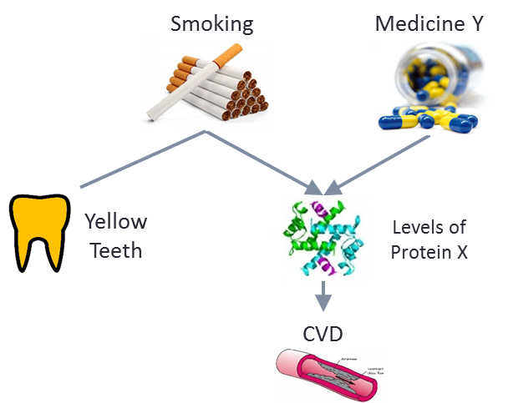
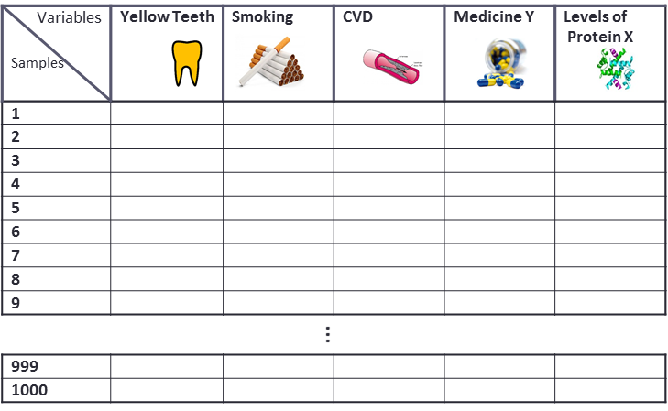
PC algorithm
Remember the assumptions:
Causal Markov Condition.
Faithfulness.
Acyclicity.
Causal Sufficiency (no hidden confounders).
INPUT
OUTPUT

Slide 89
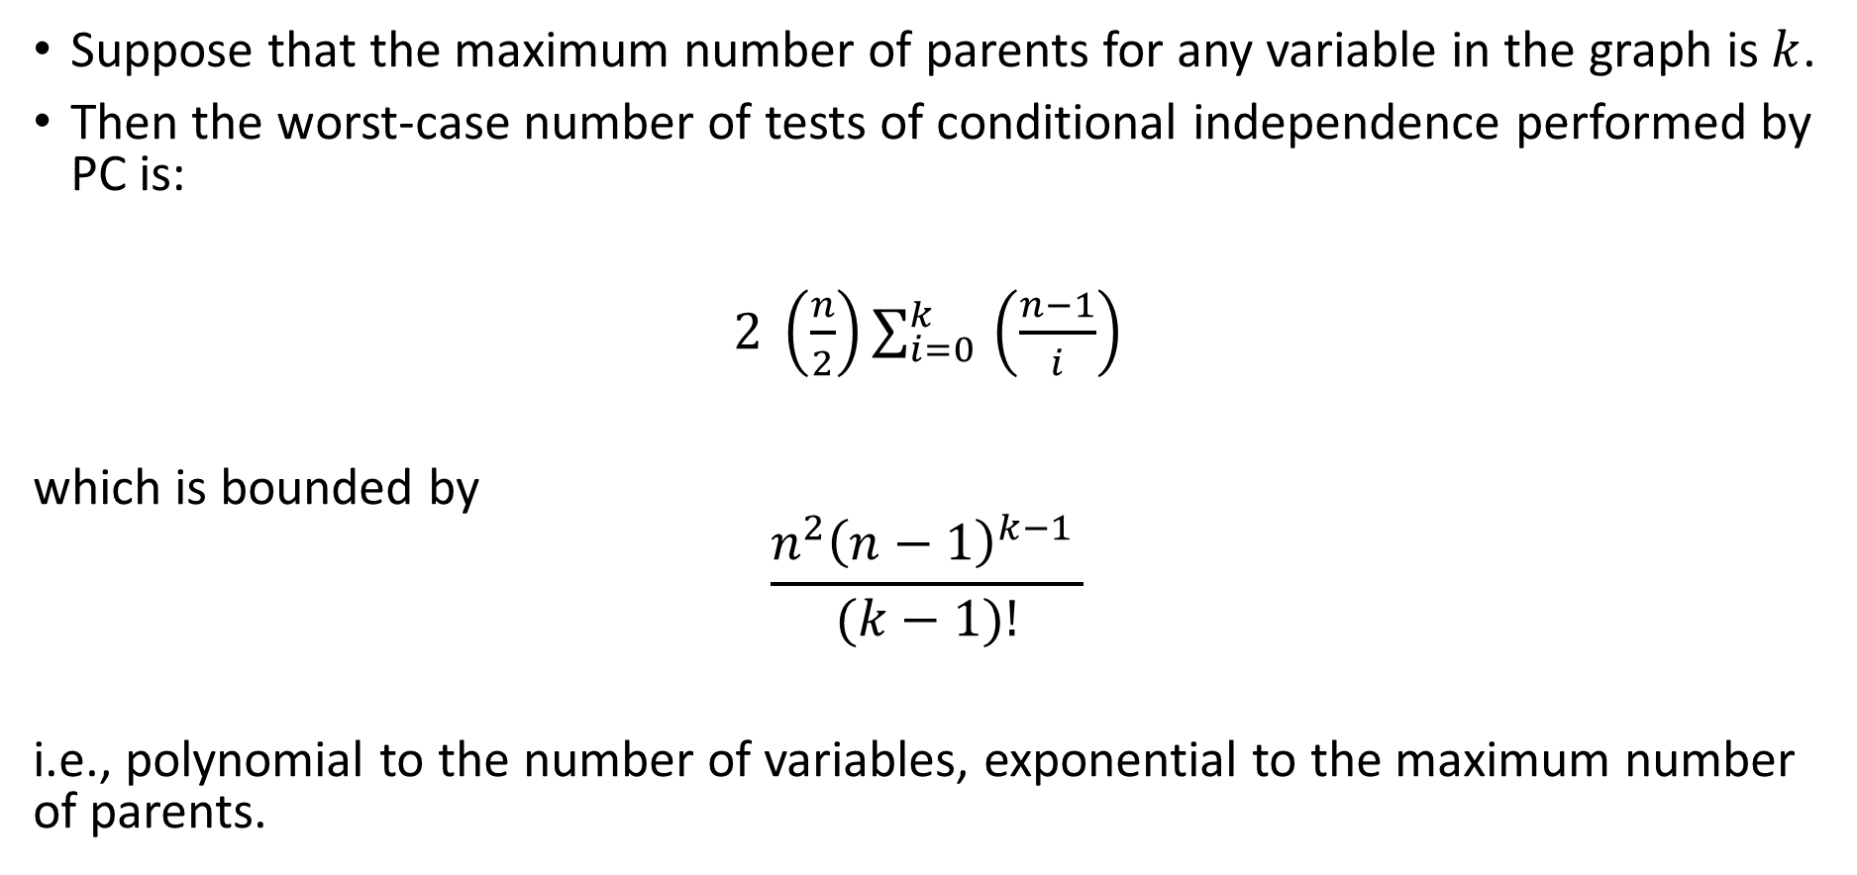
PC Algorithm - Complexity
Suppose that the maximum number of parents for any variable in the graph is $k$.
Then the worst-case number of tests of conditional independence performed by PC is:
$2 \left(\frac{n}{2}\right)\sum_{i=0 }^{k}{\left(\frac{n−1}{i}\right)}$
which is bounded by
$$\frac{n^{2}{\left(n−1\right)}^{k−1 }}{(k−1)!}$$
i.e., polynomial to the number of variables, exponential to the maximum number of parents.

Slide 90
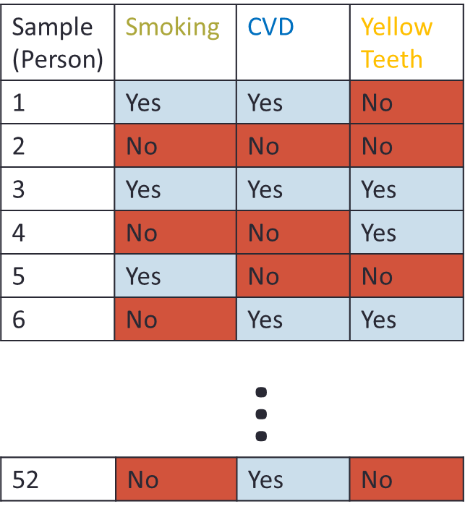
Learning causal networks as a model selection problem
Smoking
Smoking
Yellow Teeth
CVD
Yellow Teeth
CVD
Smoking
Yellow Teeth
CVD
Identify all DAGs that maximize the posterior probability of the graph given the data: P(G|D)
(or some other data-fitting criterion in general)

Slide 91
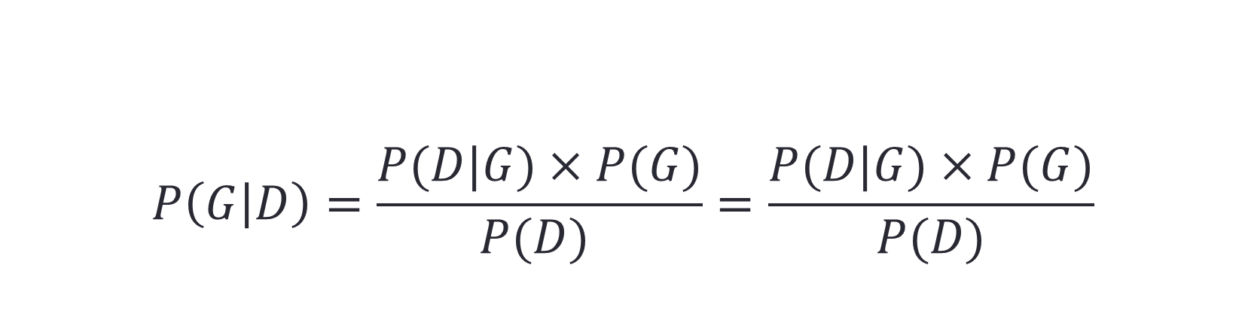
Posterior probability of the graph
Probability of the data given the graph
$$P\left(G | D\right)=\frac{P(D|G)×P(G)}{P(D) }=\frac{P(D|G)×P(G)}{P(D)}$$
Prior probability of the graph
Normalization constant

Slide 92
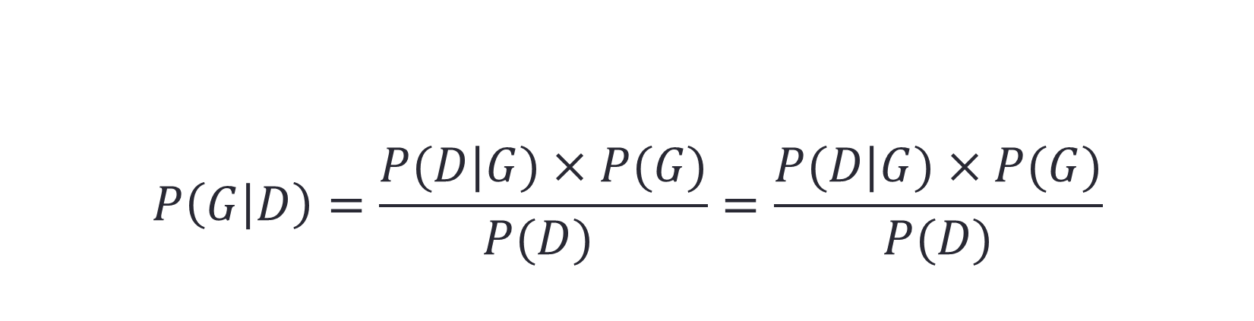
Posterior probability of the graph
Probability of the data given the graph
$$P\left(G | D\right)=\frac{P(D|G)×P(G)}{P(D) }=\frac{P(D|G)×P(G)}{P(D)}$$
Prior probability of the graph
You can ignore it since it does not depend on the graph structure.

Slide 93

Scoring function
Find G:
$argmax_{G}$ $P(D|G)×P(G)$

Slide 94
Scoring function
Uniform/based on prior knowledge/favoring sparsity
Find G:
$argmax_{G}$ $P(D|G)×P(G)$

Slide 95
Scoring function
Uniform/based on prior knowledge/favoring sparsity
Find G:
$argmax_{G}$ $P(D|G)×P(G)$
Average over all possible parameters (of the joint probability distribution).
$$\int_{θ}{P\left(D | G, θ\right)P\left(θ\right)dθ}$$

Slide 96
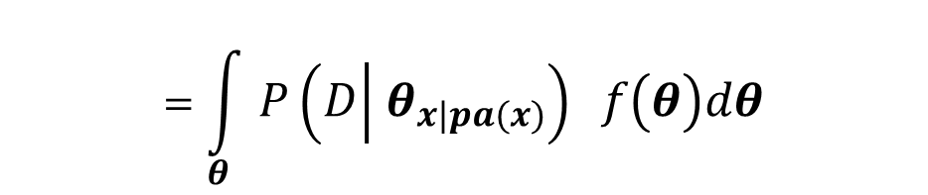
Scoring function
Uniform/based on prior knowledge/favoring sparsity
Find G:
$argmax_{G}$ $P(D|G)×P(G)$
Average over all possible parameters (of the joint probability distribution).
$$\int_{θ}{P\left(D | G, θ\right)P\left(θ\right)dθ}$$
$$=\int_{θ}{P\left(D | θ_{x|pa(x)}\right) f\left(θ\right)dθ}$$
The parameterization depends on the graphical structure.

Slide 97
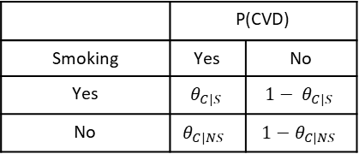
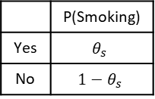
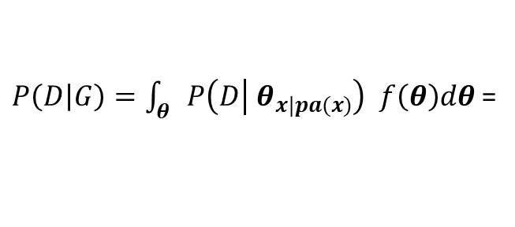
Scoring function
$P\left(D | G\right)=\int_{θ}{P\left(D | θ_{x|pa(x)}\right) f\left(θ\right)dθ}$ =
Smoking
 | P(Smoking)
Yes | $$θ_{s}$$
No | $$1−θ_{s}$$
 | P(CVD)
Smoking | Yes | No
Yes | $$θ_{C|S}$$ | $${1− θ}_{C|S}$$
No | $$θ_{C|NS}$$ | $$1−θ_{C|NS}$$
CVD

Slide 98
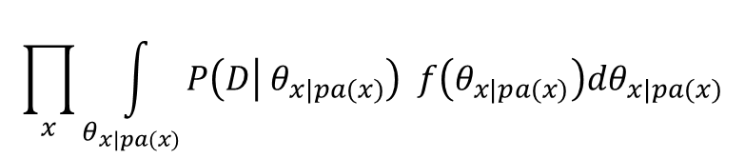
Scoring function
$P\left(D | G\right)=\int_{θ}{P\left(D | θ_{x|pa(x)}\right) f\left(θ\right)dθ}$ =
Smoking
 | P(Smoking)
Yes | $$θ_{s}$$
No | $$1−θ_{s}$$
$$\prod_{x}{\int_{θ_{x|pa(x)}}{P\left(D | θ_{x|pa(x)}\right) f\left(θ_{x|pa(x)}\right)dθ_{x|pa(x)}}}$$
 | P(CVD)
Smoking | Yes | No
Yes | $$θ_{C|S}$$ | $${1− θ}_{C|S}$$
No | $$θ_{C|NS}$$ | $$1−θ_{C|NS}$$
CVD
Score is decomposable:
It is a product of terms involving only a variable and its parents.

Slide 99
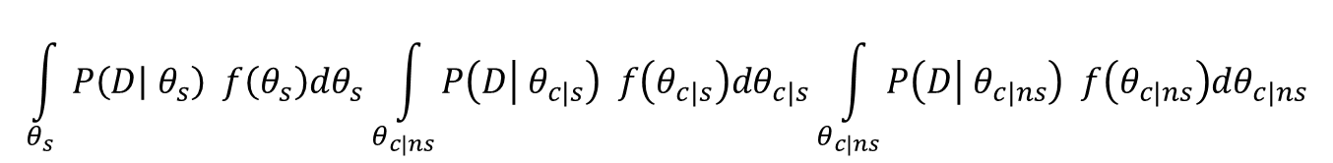
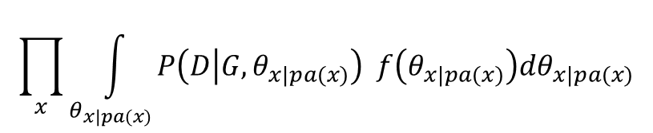
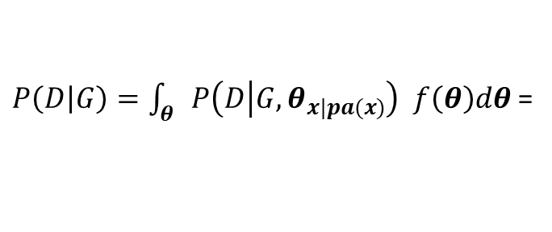
Scoring function
$P\left(D | G\right)=\int_{θ}{P\left(D | G, θ_{x|pa(x)}\right) f\left(θ\right)dθ}$ =
Smoking
 | P(Smoking)
Yes | $$θ_{s}$$
No | $$1−θ_{s}$$
$$\prod_{x}{\int_{θ_{x|pa(x)}}{P\left(D | G, θ_{x|pa(x)}\right) f\left(θ_{x|pa(x)}\right)dθ_{x|pa(x)}}}$$
 | P(CVD)
Smoking | Yes | No
Yes | $$θ_{C|S}$$ | $${1− θ}_{C|S}$$
No | $$θ_{C|NS}$$ | $$1−θ_{C|NS}$$
CVD
$$\int_{θ_{s}}{P\left(D | θ_{s}\right) f\left(θ_{s}\right)dθ_{s}}\int_{θ_{c|ns}}{P\left(D | θ_{c|s}\right) f\left(θ_{c|s}\right)dθ_{c|s}}\int_{θ_{c|ns}}{P\left(D | θ_{c|ns}\right) f\left(θ_{c|ns}\right)dθ_{c|ns}}$$

Slide 100
Scoring function
$P\left(D | G\right)=\int_{θ}{P\left(D | G, θ_{x|pa(x)}\right) f\left(θ\right)dθ}$ =
Smoking
 | P(Smoking)
Yes | $$θ_{s}$$
No | $$1−θ_{s}$$
$$\prod_{x}{\int_{θ_{x|pa(x)}}{P\left(D | G, θ_{x|pa(x)}\right) f\left(θ_{x|pa(x)}\right)dθ_{x|pa(x)}}}$$
 | P(CVD)
Smoking | Yes | No
Yes | $$θ_{C|S}$$ | $${1− θ}_{C|S}$$
No | $$θ_{C|NS}$$ | $$1−θ_{C|NS}$$
CVD
$$\int_{θ_{s}}{P\left(D | θ_{s}\right) f\left(θ_{s}\right)dθ_{s}}\int_{θ_{c|ns}}{P\left(D | θ_{c|s}\right) f\left(θ_{c|s}\right)dθ_{c|s}}\int_{θ_{c|ns}}{P\left(D | θ_{c|ns}\right) f\left(θ_{c|ns}\right)dθ_{c|ns}}$$
This score can be computed in closed form for some families of distributions that have conjugate priors

Slide 101
Example Search Strategy (Greedy Search)
Initialize G as the empty/full/random graph and score.
Score all networks that can be produced by G with a single change: adding/removing/reversing an edge, ensuring G remains a DAG (no cycles). Keep the change that resulted in the highest-scoring network.
Until no single action improves the score.

Slide 102
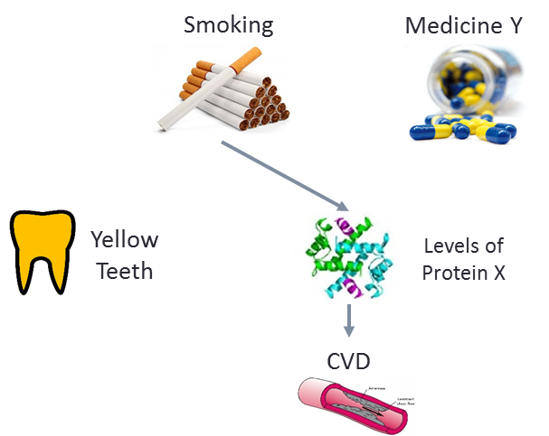
Example Search Strategy (Greedy Search)
Score=-100

Slide 103
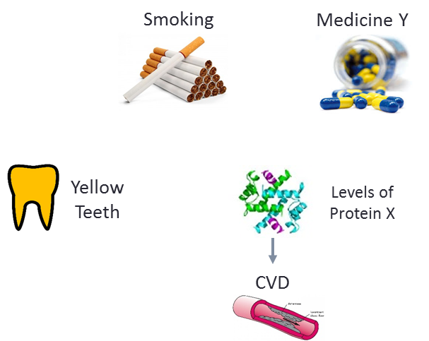


Example Search Strategy (Greedy Search)
Score=-100
Remove Smoking $→$ Protein X
Add Yellow Teeth$→$ Smoking
Reverse CVD $→$ Protein X
…
…
Score=-104
Score=-90
Score=-110

Slide 104
Example Search Strategy (Greedy Search)
Score=-100
Remove Smoking $→$ Protein X
Add Yellow Teeth$→$ Smoking
Reverse CVD $→$ Protein X
…
…
Score=-104
Score=-90
Score=-110

Slide 105
Example Search Strategy (Greedy Search)
Score=-100
Remove Smoking $→$ Protein X
Add Yellow Teeth$→$ Smoking
Reverse CVD $→$ Protein X
…
…
Score=-104
Score=-90
Score=-110

Slide 106
Search-and-Score CBN learning
Other search strategies are possible.
e.g. BFS, DFS, Genetic algorithms, TABU search.
You can search in the space of PDAGs.
e.g. GES algorithm, (Chickering, 1996)
You may get stuck in local minima.
Avoid by random restarts, simulated annealing, stochastic greedy search.
Exact methods exist for actually scoring all possible networks (e.g. Koivisto and Sood, 2004)
Using dynamic programming & bounded number of parents per variable.
$O\left(n2^{n}\right)$ space + time complexity, not possible for more than ~20-40 variables.

Slide 107
Comparison
Constraint-Based
Search-and-score
Easier to extend to different types of data (e.g., censored).
Easier to extend to networks with latent variables (next time).
More efficient in learning the skeleton of the network.
Robust to small samples.
Easier to incorporate priors on the networks.
Better in identifying the edge orientations.
Exact methods also exist, limited to ~20-40 variables.

Slide 108
Study Material
P Spirtes, C Glymour, R Scheines. Causation, Prediction and Search, MIT press, 2001.
Cooper, Gregory F., and Edward Herskovits. "A Bayesian method for the induction of probabilistic networks from data." Machine learning 9.4 (1992): 309-347.
Carvallo, A.M. Scoring functions for learning Bayesian networks, INESC-ID Tec. Rep. 54/2009 (2009).
Tsamardinos, I., Brown, L. E. & Aliferis, C. F. The max-min hill-climbing Bayesian network structure learning algorithm. Mach. Learn. 65, 31–78 (2006).
Cooper, G. F. & Yoo, C. Causal Discovery from a Mixture of Experimental and Observational Data. (UAI 1999) 10, 116–125 (1999).

Slide 109
Acyclicity
Studying
Good Grades
Studying causes Good Grades which, in turn, causes more Studying (at a later time!)…
Hard to define without explicitly representing time.
If all relations are linear, we can assume we sample from the distribution of the equilibrium of the system when external factors are kept constant.
Path-diagrams (Structural Equation Models with no measurement model part) allow such feedback loops.
Causal Markov Condition does not hold.
You can still use d-separation to identify conditional independencies.
If there is feedback and relations are not linear, there may be chaos; literally and metaphorically.
Notes:
Need to explain acyclicity

Slide 110
Causal Bayesian Networks (CBNs)
Graph G
JPD($V$): J
Smoking
 |  | CVD
Yellow Teeth | Smoking | Y | N
Y | Y | 0.17 | 0.06 | 0.13
N | Y | 0.06 | 0.02 | 0.08
Y | N | 0.02 | 0.06 | 0.08
N | N | 0.15 | 0.46 | 0.61
 |  | 0.4 | 0.6 | 1
Yellow Teeth
CVD
Causal Markov Condition
Faithfulness
Acyclicity
Causal Sufficiency
Notes:
Causal Bayesian Networks: A Graph and a probability distribution

Slide 111
Hidden Variables
Smoking
Smoking
Yellow Teeth
Tar
Yellow Teeth
CVD
Protein X
CVD
Smoking causes CVD
Smoking causes Tar increase*, which causes Protein X increase*, which causes CVD
*unobserved
Notes:
No problem: A is an direct cause of B (but only in the context of the observed variables)

Slide 112
Hidden Variables
causal relation and conditional independencies are modeled correctly
Smoking
Smoking
Yellow Teeth
Tar
Yellow Teeth
CVD
Protein X
CVD
Smoking causes CVD
Smoking causes Tar increase*, which causes Protein X increase*, which causes CVD
*unobserved
Notes:
No problem: A is an direct cause of B (but only in the context of the observed variables)

Slide 113
Hidden Variables
Genotype
Smoking
Smoking
Yellow Teeth
CVD
Yellow Teeth
CVD
Smoking causes CVD
Genotype* causes Smoking,
Genotype* causes CVD
*unobserved
Notes:
No problem: A is an direct cause of B (but only in the context of the observed variables)

Slide 114
Hidden Variables
conditional independencies are modeled correctly,
causal relations are NOT!
Genotype
Smoking
Smoking
Yellow Teeth
CVD
Yellow Teeth
CVD
Smoking causes CVD
Genotype* causes Smoking,
Genotype* causes CVD
*unobserved
Notes:
No problem: A is an direct cause of B (but only in the context of the observed variables)

Slide 115
Hidden Variables and Interventions
conditional independencies are modeled correctly,
causal relations are NOT!
Genotype
Smoking
Smoking
Yellow Teeth
CVD
Yellow Teeth
CVD
Smoking causes CVD
Genotype* causes Smoking,
Genotype* causes CVD
If you quit smoking, you will not change your probability of getting CVD!
*unobserved
Notes:
No problem: A is an direct cause of B (but only in the context of the observed variables)

Slide 116
Causal Sufficiency
Assume what is called Causal Sufficiency
No pair of variables has a latent (unobserved) common cause.
This is a pretty strong assumption.
Hidden confounders are a major reason why some people debate we absolutely need experiments.

Slide 117
A closer look in the assumptions
 | Causal Bayesian Networks
(Causal) Markov Condition | Connects structure with effect of interventions.
Faithfulness | Required for (relatively) efficient learning.
Acyclicity | Causal-feedback loops create problems with the semantics and reasoning.
Causal Sufficiency | Required to causally interpret an edge.

Slide 118
Study Material
P Spirtes, C Glymour, R Scheines. Causation, Prediction and Search, MIT press, 2001.
Heckerman, D., Geiger, D. & Chickering, D. M. Learning Bayesian networks: the combination of knowledge and statistical data. Mach. Learn. 20, 197–243 (1995).
Carvallo, A.M. Scoring functions for learning Bayesian networks, INESC-ID Tec. Rep. 54/2009 (2009).
Tsamardinos, I., Brown, L. E. & Aliferis, C. F. The max-min hill-climbing Bayesian network structure learning algorithm. Mach. Learn. 65, 31–78 (2006).
Cooper, G. F. & Yoo, C. Causal Discovery from a Mixture of Experimental and Observational Data. (UAI 1999) 10, 116–125 (1999).
Larry Wasserman, All of Statistics, Chapter 12.

